Slide 1
In the name of GOD

Slide 2
Dermatologic Diseases
Chapter 16

Slide 3
ECTODERMAL DYSPLASIA
two or more ectodermally derived anatomic structures fail to develop:
skin, hair, nails, teeth, or sweat glands
hypohidrotic ectodermal dysplasia

Slide 4
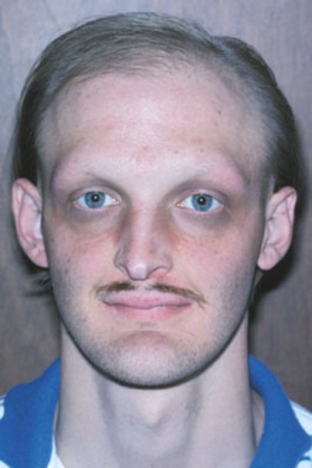
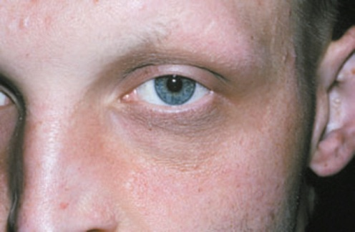
Clinical features
hypohidrotic ectodermal dysplasia
X-linked inheritance male
heat intolerance fever of undetermined origin baby
Diagnostic aid: a special impression of the patient's fingertips , count the density of the sweat glands microscopically
fine, sparse blonde hair (reduced density of eyebrow and eyelash)
The periocular skin: Fine wrinkling with hyperpigmentation
midface hypoplasia
nails : dystrophic and brittle

Slide 5
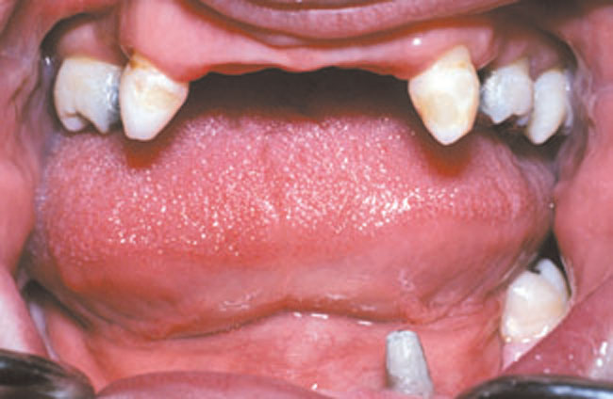
Intraoral findings
salivary glands (are ectodermally derived) xerostomia
reduced number of the teeth (oligodontia or hypodontia)
crown shapes are abnormal
The incisor crowns tapered, conical, or pointed, the molar crowns reduced diameter
Anodontia
Female patients partial expression

Slide 6
Histopathologic Features
Skin decreased number of sweat glands and hair follicles.
The adnexal structures that are present are hypoplastic and malformed.

Slide 7
Treatment and Prognosis
genetic counseling for the parents and the patient.
dental problems prosthetic replacement of the dentition, dental implants

Slide 8
WHITE SPONGE NEVUS (CANNON'S DISEASE; FAMILIAL WHITE FOLDED DYSPLASIA)
a defect in the normal keratinization of the oral mucosa (keratin 4 and keratin 13)
relatively rare genodermatosis

Slide 9
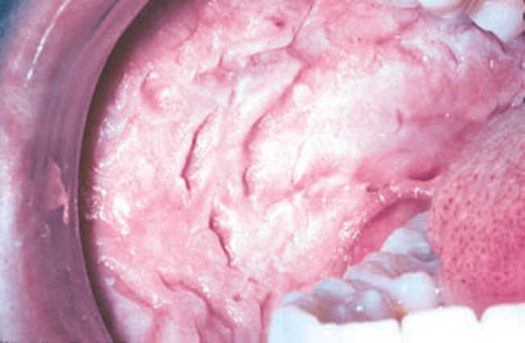
Clinical Features
usually appear at birth or in early childhood
Symmetric, thickened,white, corrugated or velvety, diffuse plaques ,buccal mucosa , bilaterally
Other intraoral sites: the ventral tongue, labial mucosa, soft palate, alveolar mucosa, and floor of the mouth
Extraoral mucosal sites: nasal, esophageal, laryngeal, and anogenital mucosa
Usually asymptomatic

Slide 10
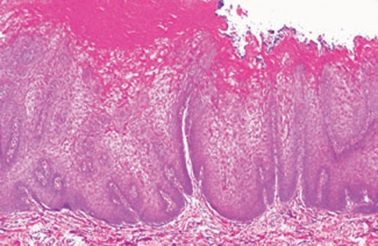
Histopathologic Features
characteristic but not pathognomonic
Prominent hyperparakeratosis , acanthosis ,clearing of the cytoplasm of the cells in the spinous layer
DD: leukoedema ,HBID
an eosinophilic condensation in the perinuclear region of the cells :keratin tonofilaments
Exfoliative cytologic studies may provide more definitive diagnostic information

Slide 11
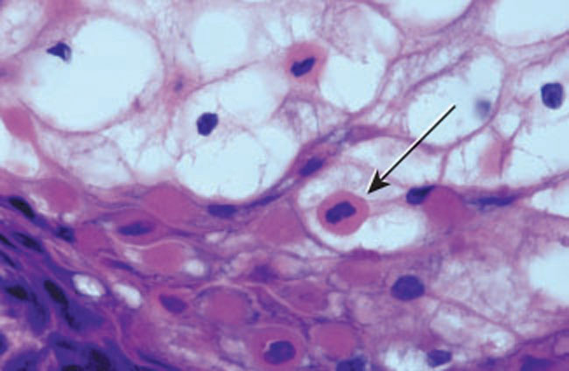

Slide 12
Treatment & Prognosis
a benign condition ---> no treatment
prognosis : good

Slide 14
DYSKERATOSIS CONGENITA (COLEENGMAN SYNDROME; ZINSSER-COLEENGMAN SYNDROME)
a rare genodermatosis
usually inherited as an X-linked recessive trait
Mutations in the DKC I gene
disrupt the normal maintenance of telomerase

Slide 15
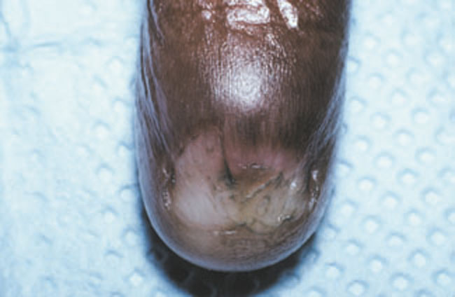
Clinical Features
During the first 10 years of life
A reticular pattern of skin hyper-pigmentation on the face, neck, and upper chest
abnormal, dysplastic changes of the nails

Slide 16
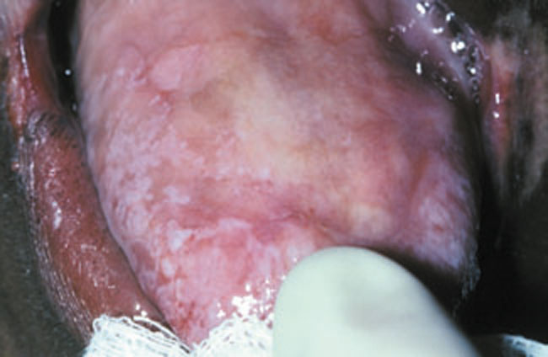
Intraoral findings
the tongue and buccal mucosa :
Bullae erosions leukoplakic lesions
The leukoplakic lesions : premalignant
1/3 become malignant (10-30y.)
Rapidly progressive periodontal disease
Thrombocytopenia (the first hematologic problem)
70% aplastic anemia

Slide 17
Histopathologic Features
early oral mucosal lesions
hyper orthokeratosis & epithelial atrophy
After progress epithelial dysplasia, squamous cell carcinoma

Slide 18
Treatment and Prognosis
Symptomatic
careful periodic oral examinations
Monitor the patient for aplastic anemia
Genetic counseling

Slide 20
XERODERMA PIGMENTOSUM
a rare genodermatosis
numerous cutaneous malignancies develop at a very early age
inability of the epithelial cells to repair UV damage → mutations in the epithelial cells → 1000 to 4000 times more skin cancer

Slide 21
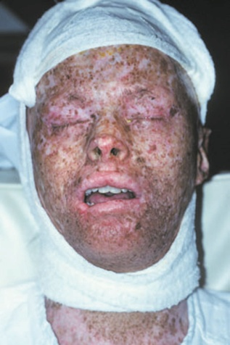
Clinical Features
Sunburn, Skin changes, such as atrophy, freckled pigmentation, and patchy depigmentation
actinic keratoses
SCC,BCC ,Melanoma(most frequently in the head and neck region)
Oral manifestations: SCC of the lower lip and the tip of the tongue.

Slide 22
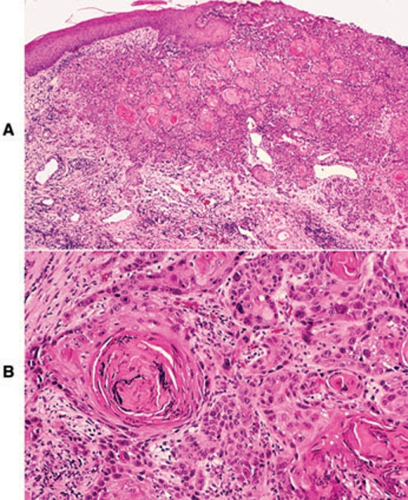
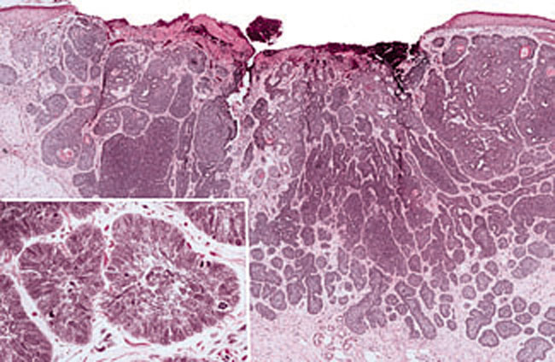
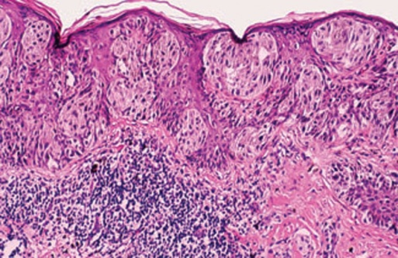
Histopathologic Features
The histopathologic features of xeroderma pigmentosum are relatively nonspecific
premalignant & malignant lesions are microscopically indistinguishable from those observed in unaffected patients.

Slide 23
Treatment and Prognosis
Avoid sunlight & unfiltered fluorescent light ,wear protective clothing, sunscreens
A dermatologist should evaluate the patient every 3 months to monitor
the development of cutaneous lesions.

Slide 24
Thank You

