Slide 1
Soft Tissue Tumors

Slide 2
Reactive and Benign lesions of Fibroblastic and Histiocytic Origin
Irritation Fibroma
Inflammatory Fibrous Hyperplasia
Inflammatory Papillary Hyperplasia
Oral Focal Mucinosis
Pyogenic Granuloma
Peripheral Giant Cell Granuloma
Peripheral Ossifying Fibroma
Benign Tunors of Fat tissue origin
Lipoma
Benign Tumors of Neural Origin
Traumatic Neuroma
Schwannoma
Neurofibroma
Granular Cell Tumor
Congenital Epulis
Melanotic Neuroectodermal Tumor of Infancy

Slide 3
Benign Tumors of Vascular Origin
Hemangioma
Lymphangioma
Benign Tumors of Muscle Origin
Leiomyoma
Rhabdomyoma
Osseous and Cartilaginous Choristomas
Malignant Tumors of Connective Tissue
Fibrosarcoma
Liposarcoma
Neurofibrosarcoma
Angiosarcoma
Kaposi’s Sarcoma
Leiomyosarcoma
Rhabdomyosarcoma
Metastases to Oral Soft Tissues

Slide 4
Lipoma
Benign tumor of fat
the most mesenchymal tumor
most of them occur in the trunk and extremities – Head and Neck are less common
Asymptomatic sessile or pedunculated soft nodular masses with yellow color
common sites: Buccal mucosa and vestibule
>40 years; female = male

Slide 5
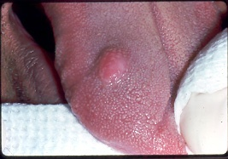

Slide 6
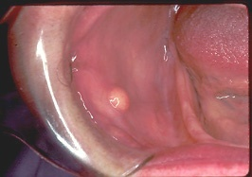

Slide 7
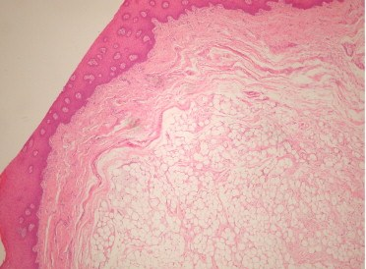
The histopathology of lipomas as well as the microscopic characteristics of normal adipose tissue are considered
classic lipomas are composed of mature adipose tissue with true lipoblasts. it is often well-circumscribed and maybe thinly encapsulated.

Slide 8
Several histologic variants described include
The most common microscopic variant
angio-lipoma,
pleomorphic lipoma,
fibrolipoma
spindle cell lipoma,
myxoid lipoma
Intramascular lipoma.

Slide 9
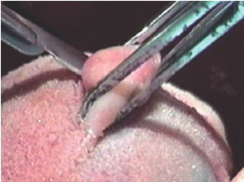
Treatment: conservative local excision
rare recurrence.
Malignant transformations or recurrences in the oral and maxillofacial regions are rare

Slide 10
Traumatic Neuroma
Reactive proliferation of neural tissue after damage to
nerve bundle
Smooth nodules
most common site: mental foramen, tongue
and lower lip with a history of trauma; intraosseous lesions
appear as radiolucencies
Any age but mostly middle-age, with F>M
Hallmark is PAIN which could be intermittent or constant
and mild or severe; Mental nerve neuromas are painful
especially with denture flange impingement

Slide 11
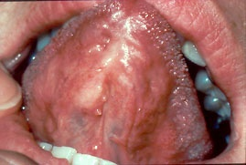

Slide 12
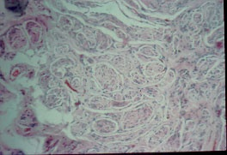
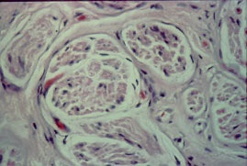
Traumatic Neuroma
Histology: Haphazard proliferation of mature, myelinated
nerve bundles within a fibrous connective tissue
Mild chronic inflammation is also seen sometimes
Treatment: Surgical excision along with a small portion of the
involved nerve; low recurrence rate

Slide 13
Palisaded Encapsulated Neuroma
Benign neural tumor common in the head and neck area
major etiological factor :Trauma
Face: 90% of cases with majority occurring on the nose
and cheek
Oral cavity: hard palate and maxillary labial mucosa
Smooth, PAINLESS nodules;
More common in adults; F=M

Slide 14
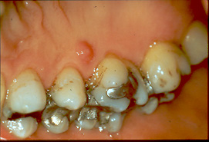

Slide 15
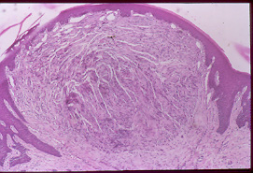
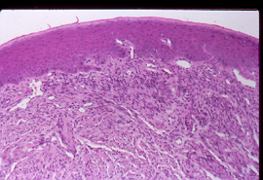
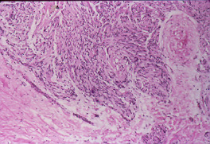
Palisaded Encapsulated Neuroma
Histology: Well-circumscribed and encapsulated with interlacing
fascicles of spindle cells (Schwann cells); wavy nuclei with no
mitotic activity or pleomorphism; parallel oriented cells
Treatment: Conservative surgical excision

Slide 16
Schwannoma (Neurilemoma)
Benign neural neoplasm of Schwann cell origin
Relatively uncommon, however 25-48% of all cases occur in
the Head and Neck area
Usually painless; slow-growing that arises in association with
a nerve trunk; Asymptomatic and pushes the nerve aside
Younger and middle-aged adults
most common location: Tongue
Intraosseous appears as unilocular or multilocular
radiolucency in posterior mandible
Pain and paresthesia

Slide 17
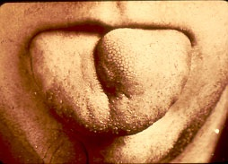

Slide 18
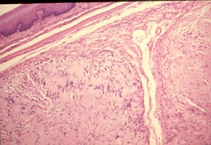
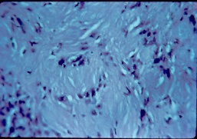
Schwannoma (Neurilemoma)
Histology: Encapsulated tumor with varying amounts of
Antoni A and Antoni B cells
Antoni A: Streaming fascicles of spindle-shaped Schwann cells;
often palisaded around acellular eosinophilic areas called
Verocay bodies (which are reduplicated basement
membrane and cytoplasmic processes)
Antoni B: less cellular and organized
Degenerative changes are seen in older lesions
Treatment: Surgical excision,no recurrence&malignant

Slide 19
Neurofibroma
MOST COMMON type of peripheral nerve tumors arising from
a mixture of Schwann cells and perineural fibroblasts
Can be solitary or associated with Neurofibromatosis
Solitary are more common and present as slow-growing, soft,
painless nodule, most common in the skin
Most common site in Oral cavity : tongue and
buccal mucosa
Intraosseous lesions also seen as poorly defined unilocular or
multilocular radiolucencies

Slide 20
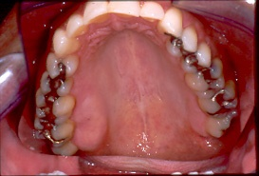

Slide 21
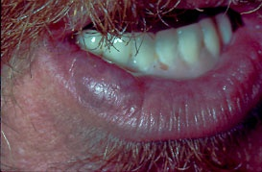

Slide 22
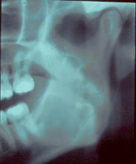
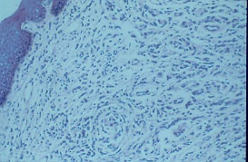
Neurofibroma
Histology: Not well-demarcated and consists of interlacing bundles of spindle-shaped cells that exhibit wavy nuclei
Numerous mast cells are present
Treatment: local surgical excision; If multiple lesions are present, patients should be evaluated for Neurofibromatosis

Slide 23
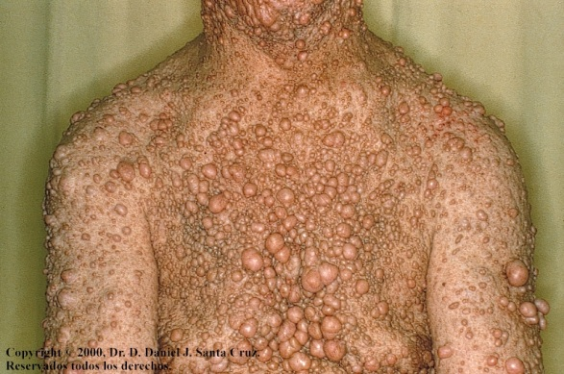
Neurofibromatosis

Slide 24
What is Neurofibromatosis?
Neurofibromatosis type I (NF1, von Recklinghausen disease ) is caused by mutation in the neurofibromin gene
An autosomal dominant neurogenetic disorder
Characterized by the presence of multiple benign neurofibromas
Affects the bone, the nervous system, soft tissue, and the skin
Clinical symptoms increase over time
Neurologic problems and malignancy may develop

Slide 25
Neurofibromatosis-1
NF-1 occurs in approximately 1 of 2500-3300 live births
This disease can involve various body systems over time
increased potential for malignant transformation of diseased tissues and the development of neurofibrosarcoma
Patients with NF-1 have about a 3-15% additional risk of malignant disease in their lifetime
Women = men

Slide 26
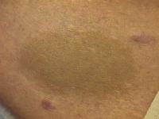
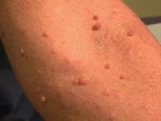
Diagnostic criteria for NF-1
(The diagnostic criteria are met if 2 or more of the features listed are present.)
Six or more café au lait macules larger than 5 mm in greatest diameter in prepubertal individuals and those larger than 15 mm in greatest diameter in postpubertal individuals
Two or more neurofibromas of any type or 1 plexiform neurofibroma
Freckling in the axillary or inguinal regions(crow’s sign)
Optic glioma
Two or more Lisch nodules (iris hamartomas)
A distinctive osseous lesion, such as sphenoid dysplasia or thinning of the long bone cortex, with or without pseudoarthrosis
A first-degree relative with NF-1 according to the above criteria

Slide 27
More Clinical Features of NF-1
Scoliosis
Pseudarthrosis of the tibia
Pheochromocytoma
Meningioma
Acoustic neuroma
Optic neuroma
Mental retardation
Hypertension
Hypoglycemia
Fibromas in Iris
Glaucoma - rare

Slide 28
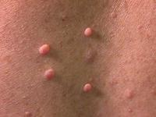
Neurofibromas
They can form at any place along a nerve
Three subtypes of neurofibroma exist: cutaneous, subcutaneous, and plexiform
Cutaneous lesions and subcutaneous lesions are circumscribed. These nodules may be brown, pink, or skin colored. They may be soft or firm to the touch
Pathognomic: Plexiform neurofibromas are noncircumscribed, thick, and irregular, and they can cause disfigurement by entwining important supportive structures

Slide 29
What is NF2?
This less common of the neurofibromatoses.
NF2 is characterized by bilateral (occurring on both sides of the body) tumors on the eighth cranial nerve. It was called bilateral acoustic schwannomas which cause progressive hearing loss.
Other Symptomes: meningiomas
CNS epandimomas

Slide 30


Slide 31
Granular Cell Tumor
Benign tumor that shows predilection to oral cavity
Derived from Schwann cells or neuroendocrine cells
Dorsal surface of TONGUE – most common site; followed by
buccal mucosa
4th to 6th decades of life and 2:1 (F:M) ratio
Asymptomatic sessile nodule that is <2 cm and appears
pink or yellow in color
Usually solitary but multiple sometimes seen in black patients
Treatment: Conservative local excision

Slide 32
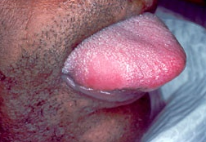

Slide 33
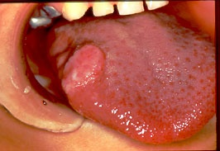

Slide 34
Granular Cell Tumor
Histology:
Large polygonal cells with abundant pale eosinophilic,
granular cytoplasm and pale nuclei
Cells arranged in sheets
Lesion is not encapsulated and appears to infiltrate into
surrounding tissues
Overlying epithelium shows acanthosis and
pseudoepitheliomatous hyperplasia
Treatment: Conservative local excision

Slide 35
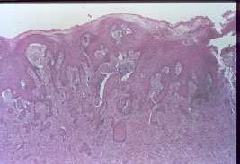
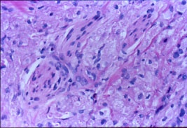
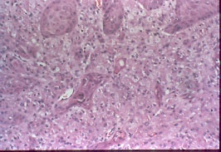
Granular Cell Tumor

Slide 36
Congenital Epulis
Occurs exclusively in the alveolar ridge of the newborn
Histologically similar to granular cell tumor, but ultrastructurally
and immunohistochemical different
Pink-red smooth surfaced mass on the alveolar ridge
of newborns
Size varies from small to over 7.5 cm with multiple tumors
also occurring in 10% of cases
Maxilla > Mandible in the area of lateral incisor and canine
STRIKING FEMALE PREDILECTION (90% cases)
Treatment: Surgical excision; spontaneous regression also seen

Slide 37
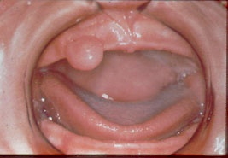

Slide 38
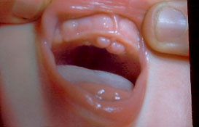

Slide 39
Melanotic Neuroectodermal Tumor of Infancy
Generally considered a benign tumor despite rapid growth
of neural crest origin
Rare pigmented neoplasm that occurs during the
first year of life
Striking predilection for the anterior maxilla (almost
2/3 of cases)
Occurs as a rapidly expanding mass that is black or
blue in color
Destroys bone and displaces associated developing teeth
Can also occur in skull, mandible, brain and testis

Slide 40
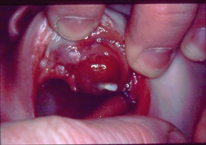

Slide 41
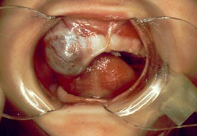

Slide 42
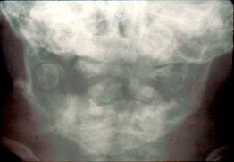
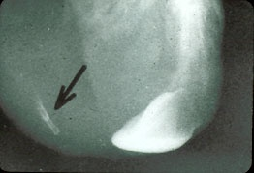
Melanotic Neuroectodermal Tumor of Infancy

Slide 43
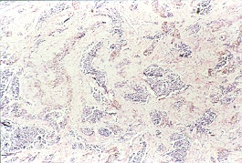
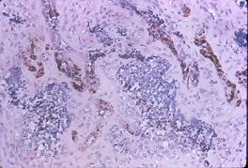
Melanotic Neuroectodermal Tumor of Infancy
Histology: Biphasic population of cells that form nests, tubules and
alveolar structures within a dense connective tissue
The 2 cell types: cuboidal epithelioid cells and neuroblastic

Slide 44
Melanotic Neuroectodermal Tumor of Infancy
Lab Tests: ↑ Vanillylmandelic acid (VMA) as in other
neural crest lesions
Treatment: Surgical removal
Rapid growth and destruction despite being
called benign
15% recurrence rate
6% behave like malignancy and metastasize

Slide 45
Hemangioma and Vascular Malformations
Hemangiomas are considered to be benign tumors of infancy
that are characterized by a rapid growth phase with endothelial
cell proliferation, followed by gradual involution
Vascular malformations are structural anomalies of blood
vessels without endothelial proliferation
Most hemangiomas are not recognized at birth, but arise during
the first 8 weeks later of life
Vascular malformations are present at birth and persist
throughout life

Slide 46
Hemangioma
Most common tumors of infancy
More common in females (3:1)
Most common in Head and Neck (60% of cases)
Mostly occurs as single lesions
Red/blue lesions that occur in skin, lips, tongue and buccal
mucosa; The lesion blanches when compressed
Intraosseous lesions also occur – Mandible > Maxilla and
occurs as multilocular radiolucency

Slide 47
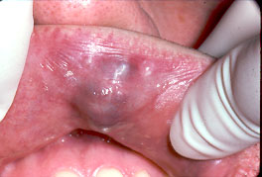

Slide 48
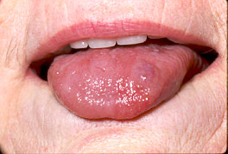

Slide 49
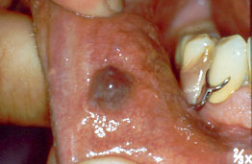

Slide 50
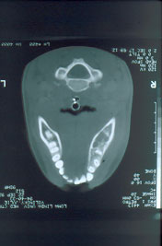
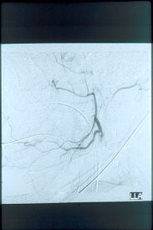

Slide 51
Vascular Malformations
Present at birth and persist throughout life
PORT-WINE STAINS are common capillary malformation
occurring most commonly on the face particularly in the area
of the trigeminal nerve
Port-wine stains are pink or purple macules that grows
proportionally with the patient; Older patients have darker
lesions and becomes nodular

Slide 52
Hemangioma
Histology
Cellular Hemangioma
Capillary Hemangioma
Cavernous Hemangioma
Treatment: Most congenital lesions will involute (“Watchful
Neglect”)
Surgical removal and sclerotherapy with 95% ethanol

Slide 53
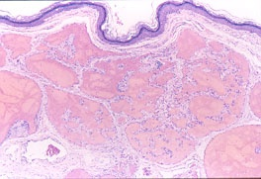
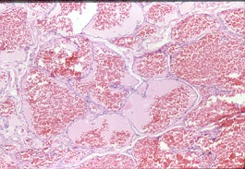

Slide 54
Sturge-Weber Syndrome
Hamartomatous vascular proliferation of the face and brain
Dermal capillary malformation (Port wine stain) in a unilateral
distribution along one or more segments of trigeminal nerve
Leptomeningeal angiomas involving the ipsilateral cortex
revealing “tramline” calcifications on X-rays
Mental retardation and convulsions
Eye involvement: glaucoma and vascular malformations
Intraoral: Vascular involvement of the ipsilateral oral mucosa

Slide 55
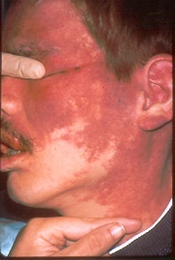
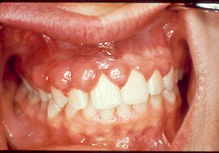

Slide 56
Lymphangioma
Benign hamartomatous tumors of lymphatic vessels
Predilection to the head and neck with 50 – 75% occurring
Three types: capillary; cavernous and cystic lymphangiomas
Cavernous lymphangiomas are most common in oral cavity
Most frequent site in the oral cavity - anterior 2/3 of the tongue
where it causes MACROGLOSSIA
Pebbly surface resembling cluster of translucent vesicles
(similar to frog eggs)

Slide 57
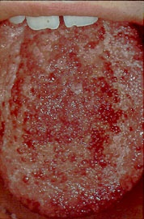
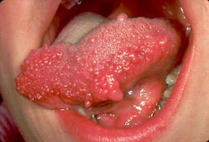

Slide 58
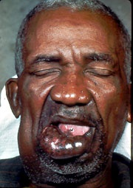

Slide 59
Cystic Hygroma (Cystic Lymphangiomas)
Most commonly occur in the neck and axilla
Cervical lymphangiomas are most common in the
posterior triangle and are soft, fluctuant masses
Occasionally could extend into the mediastinum or
upward into oral cavity ; could also extend into the
anterior triangle resulting in respiratory difficulties
or dysphagia

Slide 60
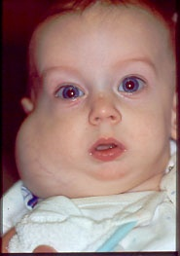
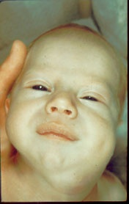

Slide 61
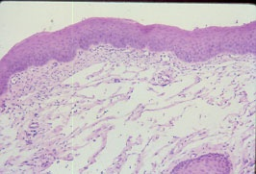

Histology
Treatment
Intraoral: Excision and prognosis is good; recurrence does occur
Cystic: Well circumscribed and have lower recurrence rate
SCLEROSING AGENTS DO NOT WORK AS IN HEMANGIOMAS

Slide 62
Leiomyoma
Benign neoplasms of smooth muscle
Most of these have origin in the vascular smooth muscle
3 types: SOLID, VASCULAR AND EPITHELIOID
75% of oral cases are vascular leiomyomas
Can occur at any age; slow-growing mucosal nodule that
occasionally can be PAINFUL
Commonly seen in lips, tongue, palate and cheek
Local surgical excision

Slide 63
Rhabdomyoma
Benign neoplasm of skeletal muscle
Adult and Fetal types
Adult: Middle-aged and older patients; M>F
Intraoral lesions: FOM, soft palate and base of the tongue
Nodule or mass that grows for many years
Fetal: Young children with a male predilection; face and
periauricular region
Treatment: local surgical excision

Slide 64
Osseous and Cartilagenous Choristomas
Choristoma is a tumorlike growth of microscopically normal
tissue in an abnormal location
Bone, cartilage or both
TONGUE (85% of cases); especially posterior tongue near the
foramen cecum
Gagging or dysphagia are common symptoms
Histology: well-circumscribed mass of dense lamellar bone
or mature cartilage
Treatment: Surgical excision

Slide 65



Slide 66



Slide 67


Slide 68


Slide 69
DENTAL CHORISTOMA: THE FIRST CASE OF ECTOPIC
DEVELOPING TOOTH IN THE TONGUE

Slide 70
Soft Tissue Sarcomas
Account for less than 1% of cancers in the oral and
maxillofacial area
Fibrosarcoma
Malignant fibrous histiocytoma
Liposarcoma
Malignant peripheral nerve sheath tumor
Olfactory neuroblastoma
Kaposi’s sarcoma
Leiomyosarcoma
Rhabdomyosarcoma
Synovial sarcoma
Alveolar soft part sarcoma

Slide 71
Rhabdomyosarcoma
Malignant neoplasm of skeletal muscle origin
MOST COMMON SOFT TISSUE SARCOMA IN CHILDREN
HEAD AND NECK IS THE MOST SITE (40% of cases)
Primarily occurs in the first decade, teenagers and young adults
60% of cases occurs in males
Painless infiltrative mass that grows rapidly
Orbit > nasal cavity and nasopharynx
Intraoral: PALATE

Slide 72


Slide 73
3 Histologic Types
Embryonal, Alveolar and Pleomorphic
The head and neck cases are either embryonal or alveolar
Embryonal: First 10 years of life and 60% of cases
Alveolar: occurs between 10-25 years and accounts for
20% - 30% of cases
Treatment: Local surgical excision followed by multiagent
chemotherapy (vincristine, actinomycin D and
cyclophosphamide)
Radiation therapy
Prognosis: 5 year survival rate is 60% to 70%

Slide 74



Slide 75
Metastases to Oral Soft Tissues
Uncommon representing 1% of all oral malignancies
Oral metastases can occur in bone and soft tissues
Lymphatic and blood-borne route
Batson’s plexus: a valveless vertebral venous plexus that
might allow retrograde spread of tumor cells, bypassing
filtration through the lungs
GINGIVA followed by the tongue
Nodular masses often resembling hyperplastic or reactive
growths with occasional ulcerations and loosening of
adjacent teeth

Slide 76


Slide 77


Slide 78
Metastases to Oral Soft Tissues
Oral metastases is more common in males
More common in middle-aged and older adults
Male: Primary tumor is seen in lung cancer
Female: Primary tumor is seen in breast cancer (25% of cases)
In most cases, the primary tumor is known before the
metastases is discovered; HOWEVER IN SOME CASES THE
ORAL LESION IS THE FIRST SIGN OF MALIGNANT DISEASE
Histology is similar to the primary tumor
MOST CASES TO ORAL CAVITY ARE CARCINOMAS AND
NOT SARCOMAS
Treatment: Poor prognosis; palliative management

