Slide 2
Embryology and Histogenesis of Dental Bud
لطفا یرای شنیدن بهتر فایل های صوتی از گوشی استفاده کنید و به متن نوشته شده در کنار هر اسلاید دقت کنید شماره فایل های صوتی با شماره اسلاید مطابقت دارد.

Slide 3
Odontogenesis

Slide 4
Stages of Development
Bell stage: Histo and morpho differentiation
1- Oral epithelum
2-Dental lamina
3-Outer enamel epithelum
4-Inner ename epithelium
5- Stratum intermedium
6-Stellate reticulum
7-Dental papilla
8-Dental follicule
1
2
3
6
4
5
7
8
8

Slide 5
Odontogenic tumors
Epithelial Tumors:
•Ameloblastoma
Malignant Ameloblastoma
Ameloblastic carcinoma
•Adenomatoid odontogenic tumor
•Calcifying epithelial odontogenic
tumor (Pindborg tumor)
•Squamous odontogenic tumor
•Clear cell odontogenic carcinoma

Slide 6
Ameloblastoma
AMELOBLASTOMA
The ameloblastoma is the most common clinically significant
odontogenic tumor. Its relative frequency equals
the combined frequency of all other odontogenic tumors,
excluding odontomas. Ameloblastomas are tumors of odontogenic epithelial origin. Theoretically, they may arise from rests of dental lamina, from a developing enamel organ, from the epithelial lining of an odontogenic cyst, or from the basal cells of the oral mucosa.
Ameloblastomas are slow-growing, locally invasive tumors that run a benign course in most cases. They occur in three different clinicoradiographic situations which deserve separate consideration because of differing therapeutic considerations and prognosis.

Slide 7
Types of Ameloblastoma
I. Conventional solid or multicystic (about 86% of all cases),
2. Unicystic (about 13 % of all cases), and
3. Peripheral (extraosseous) (about 1 % of all cases).

Slide 8
Odontogenic Tumors
Ameloblastoma Ademantinoma-blastoma
Definition:Slow growing,Unifocal,Nonfunctional
Benign Microscopicaly but persistant Clinicaly
Clacification:Centeral(solid,Multicystic) ,Unicystic, Peripheral
Pitutary Ameloblastoma
(Craniopharyngioma)
Ademantinoma of long bone
Histogenesis:Dental organ,Dental lamina

Slide 9
CONVENTIONAL SOLID OR MULTICYSTIC INTRAOSSEOUS AMELOBLASTOMA

Slide 10
CONVENTIONAL SOLID OR MULTICYSTIC INTRAOSSEOUS AMELOBLASTOMA

Slide 11
CONVENTIONAL SOLID OR MULTICYSTIC INTRAOSSEOUS AMELOBLASTOMA
1
2
3

Slide 12
CONVENTIONAL SOLID OR MULTICYSTIC INTRAOSSEOUS AMELOBLASTOMA
Variable sized masses and cords of infiltrating odontogenic epithelium in a dense, mature fibrous connective tissue stroma.

Slide 13
CONVENTIONAL SOLID OR MULTICYSTIC INTRAOSSEOUS AMELOBLASTOMA
Peripheral columnar basal cell layer with central zones of loose stellate reticulum type epithelium.

Slide 14
CONVENTIONAL SOLID OR MULTICYSTIC INTRAOSSEOUS AMELOBLASTOMA
Squamous metaplasia of stellate reticulum with keratin formation in larger epithelial masses (Acanthmatous pattern).

Slide 15
CONVENTIONAL SOLID OR MULTICYSTIC INTRAOSSEOUS AMELOBLASTOMA

Slide 16
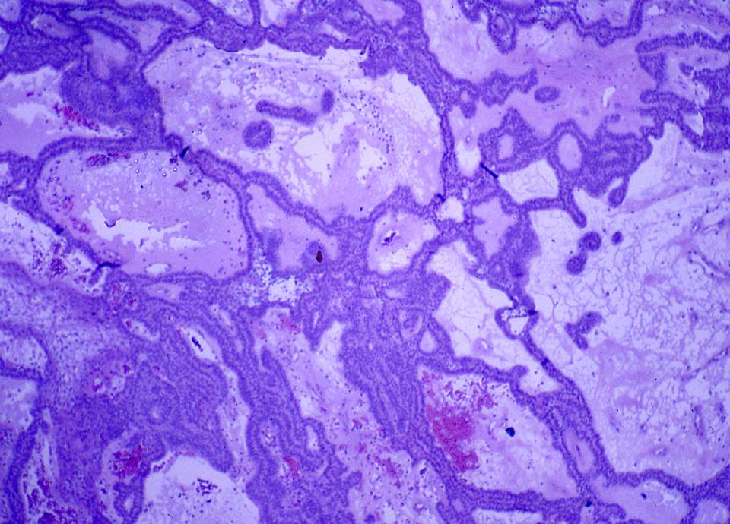

Slide 17
CONVENTIONAL SOLID OR MULTICYSTIC INTRAOSSEOUS AMELOBLASTOMA

Slide 18
CONVENTIONAL SOLID OR MULTICYSTIC INTRAOSSEOUS AMELOBLASTOMA

Slide 19
CONVENTIONAL SOLID OR MULTICYSTIC INTRAOSSEOUS AMELOBLASTOMA

Slide 20
Unicytstic Ameloblastoma
Unicytstic Ameloblastoma
The radiographic appearance of this asymptomatic ameloblastoma is more suggestive of a dentigerous cyst.

Slide 21
UNICYSTIC AMELOBLASTOMA
The unicystic ameloblastoma deserves separate consideration based on its clinical, radiographic, and pathologic features and its response to treatment. Unicystic ameloblastomas account for 10% to 15 % of all intraosseous ameloblastomas in various studies. Whether the unicystic ameloblastoma originates de novo as a neoplasm or whether it is the result of neoplastic transformation of nonneoplastic cyst epithelium has been long debated. Both mechanisms probably occur, but proof of which is involved in an individual patient is virtually impossible to obtain.

Slide 22
UNICYSTIC AMELOBLASTOMA
Clinical and Radiographic Features
Unicystic ameloblastomas are most often seen in younger patients, with about 50% of all such tumors diagnosed during the second decade of life. The average age in one large series was 23 years. More than 90% of unicystic ameloblastomas are found in the mandible, usually in the posterior regions. The lesion is often asymptomatic, although large lesions may cause a painless swelling of the jaws. In many patients, this lesion typically appears as a circumscribed radiolucency that surrounds the crown of an unerupted mandibular third molar, clinically resembling a dentigerous cyst.

Slide 23
UNICYSTIC AMELOBLASTOMA

Slide 24
Ameloblastoma
ادامه نمای هیستوپاتوژی:
نوع یونی سیستیک: سه نوع اصلی هیستوپاتولوژیک آملوبلاستومای یونی سیستیک دیده می شود:⁵ 1.لومینال 2.اینترالومینال 3.مورال
1
3
2

Slide 25
UNICYSTIC AMELOBLASTOMA
Histopathologic Features
Three histopathologic variants of unicystic ameloblastoma have been described. In the first type (luminal unicystic ameloblastoma), the tumor is confined to the luminal surface of the cyst. The lesion consists of a fibrous cyst wall with a lining that consists totally or partially of ameloblastic epithelium. This demonstrates a basal layer of columnar or cuboidal cells with hyperchromatic nuclei that show reverse polarity and basilar cytoplasmic vacuolizatio. The overlying epithelial cells are loosely cohesive and resemble stellate reticulum. This finding does not seem to be related
to inflammatory edema.
لومن کیست
استرومای همبندی کیست

Slide 26
UNICYSTIC AMELOBLASTOMA
In the osecond microscopic variant, one or more nodules of ameloblastoma project from the cystic lining into the lumen Of the cyst. This type is called an intraluminal unicystic ameloblastoma. These nodules may be relatively small or largely fill the cystic lumen. In some cases, the nodule of tumor that projects into the lumen demonstrates an edematous, plexiform pattern that resembles the plexiform pattern seen in conventional ameloblastomas
These lesions are sometimes referred to as plexiform unicystic ameloblastomas.
لومن کیست

Slide 27
UNICYSTIC AMELOBLASTOMA
In the third variant, known as mural unicystic meloblastoma, the fibrous wall of the cyst is infiltrated by typical follicular or plexiform ameloblastoma. The extent and depth of the ameloblastic infiltration may vary considerably. With any presumed unicystic ameloblastoma, multiple sections through many levels of the specimen are necessary to rule out the possibility of mural invasion of tumor cells.
استرومای همبندی کیست
لومن کیست

Slide 28
PERIPHERAL (EXTRAOSSEOUS) AMELOBLASTOMA
The peripheral ameloblastoma is uncommon and accounts for about I % of all meloblastomas. This tumor probably arises from rests of dental lamina beneath the oral mucosa or from the basal epithelial cells of the surface epithelium. Histopathologically. these lesions have the same features as the intraosseous form of the tumor.

Slide 29
PERIPHERAL (EXTRAOSSEOUS) AMELOBLASTOMA
Clinical Features
The peripheral ameloblastoma is usually a painless, non ulcerated sessile or pedunculated gingival or alveolar mucosal lesion. The clinical features are nonspecific, and most lesions are clinically considered to represent a fibroma or pyogenic granuloma. Most examples are Peripheral ameloblastomas are most commonly found on the posterior gingival and alveolar mucosa, and they are somewhat more common in mandibular than in maxillary areas. In some cases, the superficial alveolar bone becomes slightly eroded, but significant bone involvement does not occur.

Slide 30
PERIPHERAL (EXTRAOSSEOUS) AMELOBLASTOMA
Histopathologic Features
Peripheral ameloblastomas have islands of ameloblastic
epithelium that occupy the lamina propria underneath the surface epithelium. The proliferating epithelium may show any of the features described for the intraosseous meloblastoma; plexiform or follicular patterns are the most common. Connection of the tumor with the basal layer of the surface epithelium is seen in about 50% of cases.

Slide 31
Ameloblastoma Follicular type

Slide 32
Ameloblastoma Follicul type

Slide 33
Ameloblastoma Follicular type

Slide 34
Ameloblastoma Follicular type

Slide 35
Ameloblastoma Plexiform type

Slide 36
Ameloblastoma Follicular Type

Slide 37
UNICYSTIC Type PLEXIFORM AMELOBLASTOMA

Slide 38
UNICYSTIC TYPE PLEXIFORM AMELOBLASTOMA
لومن کیست

Slide 39
UNICYSTIC TYPE FOLLICULAR AMELOBLASTOMA

Slide 40
UNICYSTIC TYPE FOLLICULAR AMELOBLASTOMA

Slide 41
PERIPHERAL (EXTRAOSSEOUS) AMELOBLASTOMA

Slide 42
PERIPHERAL (EXTRAOSSEOUS) AMELOBLASTOMA

Slide 43
PERIPHERAL (EXTRAOSSEOUS) AMELOBLASTOMA

Slide 44
PERIPHERAL (EXTRAOSSEOUS) AMELOBLASTOMA

Slide 45
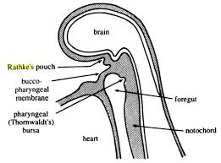
Pitutary Ameloblastoma Craniopharyngioma
Rathk’s pouch tumor
Histogenesis
Frequency:%2.5 among 6000 CNS tumor
Site:above or in the sella torsica
Histologic difference:bone,cartilage,dystrophic calcification,tooth structure
Prognosis:poor,sever side effects

Slide 46
PRIMARY INTRA-ALVEOLAR EPIDERMOID CARCINOMA
Definition:Primary means not from metastasise,superficial mucosa,maxillary sinus
Difference of jaw bone with other bone:
Remnant of epithelium from odontogen,fissural,ectopic salivary gland.

Slide 47
Odontogenic Tumors
PRIMARY INTRA-ALVEOLAR EPIDERMOID CARCINOMA
Definition:Primary means not from metastasise,superficial mucosa,maxillary sinus
Difference of jaw bone with other bone:
Remnant of epithelium from odontogen,fissural,ectopic salivary gland

Slide 48
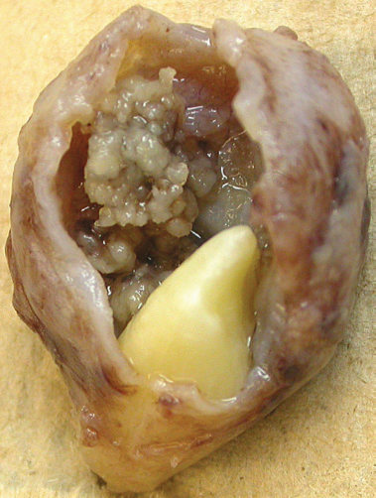
ADENOMATOID ODONTOGENIC TUMOR
Histogenesis:A mixed tumor?
Site:%65max>%35man anterior region
Usually with impacted upper canine
Gender:%64female>%36male
Clinical sign:none,swelling
Radiographic app:Like dentigerous cyst but Beyond CEJ
mixed appearance
Peripheral variant is rare.

Slide 49
ADENOMATOID ODONTOGENIC TUMOR
Histologic app:Cellular paranchyma consisting of spindle and polygonal cell
Ductal structure sorrounded by preameloblast
Ameloid materials,intraductal or intercellular
Calcifyied materials:Enameloid,Dentinoid
Osteodentin,Cementoid
Traetment:Simple enucleation
Prognosis:No recurrence

Slide 50
SQUAMOUS ODONTOGENIC TUMOR
Histogenesis:hamarthoma:
Mallasess
Reasons of importance:Primary intra-alveolar SCC,Acantomathous Ameloblastoma
Site:man=max anterior of maxilla,posterior of mandibule
Gender:None 11-67 yrs
Clinical signs:Asymptomatic,sometimes losening of tooth,pain and tenderness

Slide 51
SQUAMOUS ODONTOGENIC TUMOR
Radiographic app:
Semilunar or triangular radiolucency near CEJ

Slide 52
Cacifying Epithelial Odontogenic Tumor (PINDBORG TUMOR)
Histogenesis:REE,
Stratum Intermedium
Site:2man>1max.
3molar>1premolar
Gender:equal,mean age 40yrs
%50 with impacted tooth.

Slide 53
CALCIFYING EPITHELIAL ODONTOGENIC TUMOR (PINDBORG TUMOR)
The calcifying epithelial odontogenic tumor, also
widely known as the Pindborg tumor, is an uncommon lesion that accounts for less than 1 % of all odontogenic tumors. Few cases have been reported to date.
Although the tumor is clearly of odontogenic origin, its
histogenesis is uncertain.

Slide 54
Radiographic appearance
Uni-Multilocular radiolucency,Mixed appearance.Driven snow

Slide 55
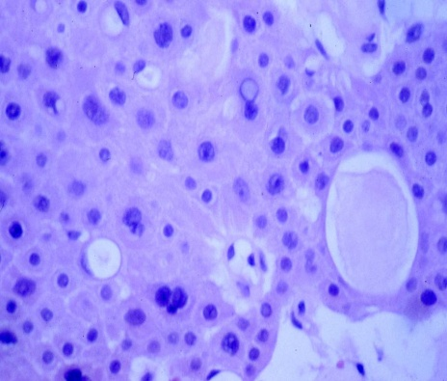
Odontogenic Tumors
Cacifying Epithelial Odontogenic Tumor (PINDBORG TUMOR)
Clinical signs:slow growing,expansile mass
Histologic app:Pleomorphism,giant cell.amyloid like material,Liesgang rings
Amyloid materials:Enamel matrix,keratin,glycoprotiens,basal lamina
Treatment:Resection with a proper margin
Prognosis:%14 recurrence

Slide 56
Cacifying Epithelial Odontogenic Tumor
Calcifying Epithelial Odontogenic Tumor. With
Congo red staining, the pools of amyloid exhibit an apple-green birefringence
when viewed with polarized light.
به سلول ژآنت (پیکان) توجه کنید.

Slide 57
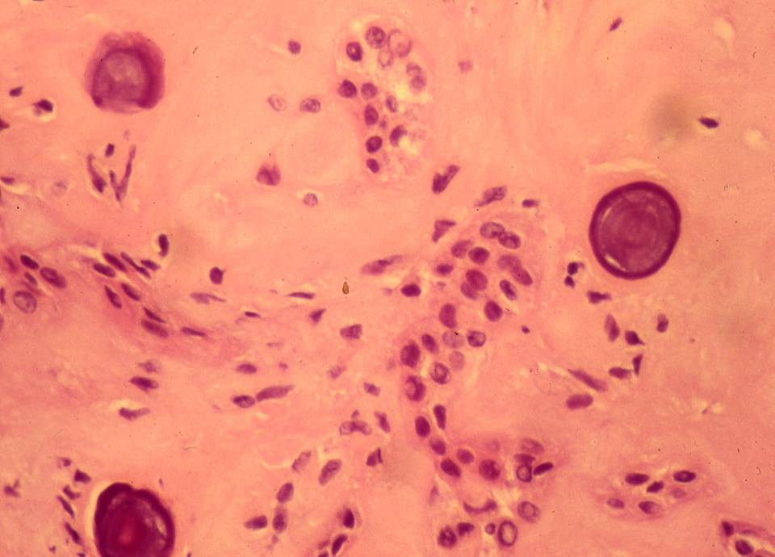
Liesgang rings

Slide 58
Clear cell odontogenic carcinoma
Clear cell odontogenic carcinoma is a rare jaw tumor that was first described in 1985. To date, approximately 80 examples have been documented. The tumor appears to be of odontogenic origin, but its histogenesis is uncertain.
Histochemical and ultrastructural studies have suggested that the clear cells, which are the prominent feature of this neoplasm, may have similarities to glycogen-rich presecretory ameloblasts.

Slide 59
Clinical and Radiographic Features
The clear cell odontogenic carcinoma exhibits a variable clinical pattern. A wide age range (from 14 to 89 years of age) has been described, but most cases are patients older than age 50. Nearly 80% of the lesions develop in the mandible.
Radiographically, the lesions appear as unilocular or multilocular radiolucencies. The margins of the radiolucency are often somewhat ill-defined or irregular.

Slide 60
Histopathologic Features
Three histopathologic patterns have been described for clear cell odontogenic carcinoma. The biphasic pattern consists of varying-sized nests of epithelial cells, with a clear or faintly eosinophilic cytoplasm admixed with more eosinophilic polygonal epithelial cells.
Clear Cell Odontogenic Carcinoma. Hyperchromatic epithelial nests including clusters of cells with abundant clear cytoplasm.

Slide 61
Treatment and Prognosis
Clear cell odontogenic carcinomas largely demonstrate an aggressive clinical course, with invasion of contiguous structures and a significant tendency to recur, particularly if the initial treatment is enucleation or curettage. Most patients require fairly radical surgery. Metastatic involvement of regional lymph nodes has been documented in 20% to 25% of these patients, and pulmonary metastases have been described as well.

Slide 62
Oral and Maxillofacial Pathology Neville
چاپ چهارم فصل 15 برای مطالعه بیشتر و امتحان

