Slide 1
Salivary Gland Pathology
The mucocele is a common lesion of the oral mucosa that results from rupture of a salivary gland duct and spillage of mucin into the surrounding soft tissues. This spillage is often the result of local trauma, although there is no known history of trauma in many cases. Unlike the salivary duct cyst the mucocele is not a true cyst because it lacks an epithelial lining. Some authors, however, have included true salivary duct cysts
in their reported series of "mucoceles."

Slide 2
Salivary Gland Pathology
Clinical Features
Mucoceles typically appear as dome-shaped mucosal swellings that can range from 1 or 2 mm to several centimeters in size .They are most common in children and young adults, perhaps because younger people are more likely to experience trauma that induces mucin spillage. However, mucoceles have been reported in patients of all ages, including newborn infants and older people. The spilled mucin below the mucosal surface often imparts a bluish translucent hue to the swelling, although deeper mucoceles may be normal in color.

Slide 3
Salivary Gland Pathology
most patients report that the lesion has been present for several weeks. Many patients relate a history of a recurrent swelling that periodically may rupture and release its fluid contents. The lower lip is the most common site for the mucocele,accounting for over 60% of all cases. Mucoceles usually are found lateral to the midline. Less common sites include the buccal mucosa,anterior ventral tongue, and floor of mouth (ranula). Mucoceles rarely develop on the upper lip. This is in contradistinction to salivary gland tumors, which are not unusual in the upper lip but are distinctly uncommon in the lower lip.

Slide 4
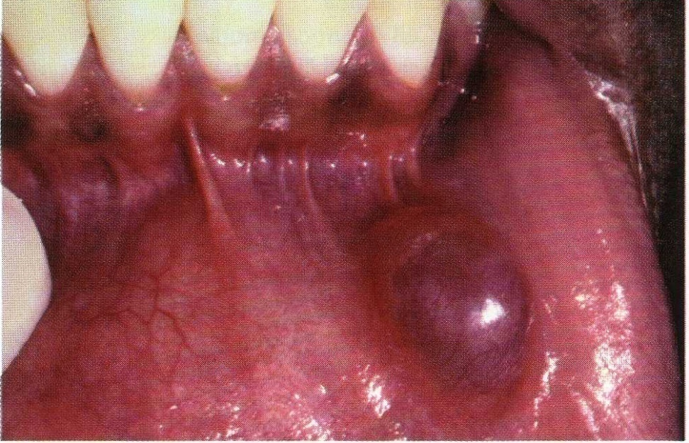
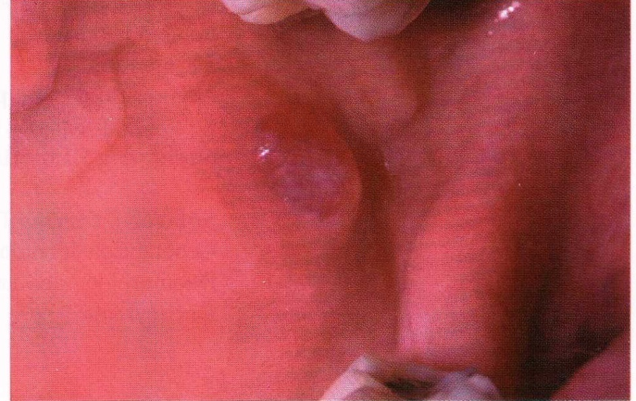
Salivary Gland Pathology
Mucocele. Blue-pigmented nodule on the lower lip.
Mucocele. Nodule on the posterior buccal mucosa.

Slide 5
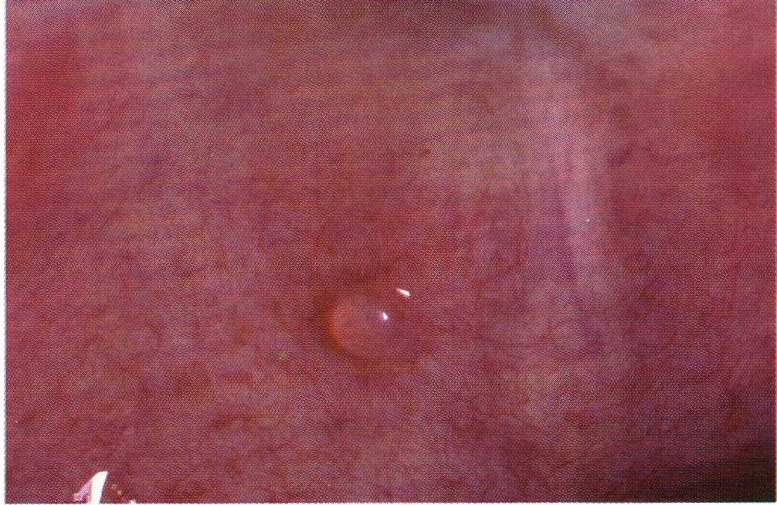
Salivary Gland Pathology
The soft palate and retromolar area are also uncommon sites for mucoceles. However, one interesting variant, the superficial mucocele, does develop in these areas and along the posterior buccal mucosa. Superficial mucoceles present as single or multiple tense vesicles that measure 1 to 4 mm in diameter.

Slide 6
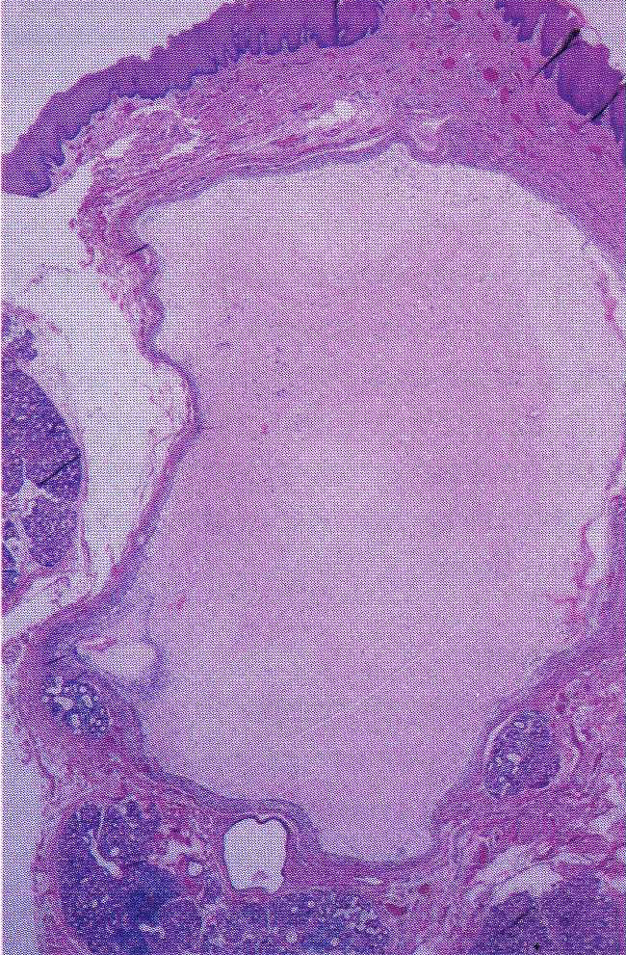
Salivary Gland Pathology
Histopathologic Features
On microscopic examination, the mucocele shows an area of spilled mucin surrounded by a granulation tissue response The inflammation usually includes numerous foamy histiocytes (macrophages).
In some cases, a ruptured salivary duct may be identified feeding into the area. The adjacent minor salivary glands often contain a chronic inflammatory cell infiltrate and dilated ducts.

Slide 7
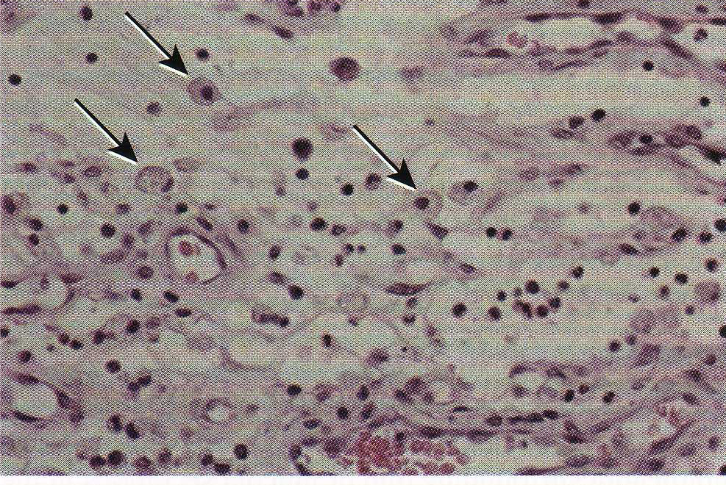
Salivary Gland Pathology
Foamy histocytes (mucinophages)

Slide 8
Salivary Gland Pathology
T r e a t m e n t a n d P r o g n o s i s
Some mucoceles are short-lived lesions that rupture and heal by themselves. Many lesions, however, are chronic in nature, and local surgical excision is necessary. To minimize the risk of recurrence, when the area is excised, the surgeon should remove any adjacent minor salivary glands that may be feeding into the lesion. The excised tissue should be submitted for microscopic examination to confirm the diagnosis and rule out the possibility of a salivary gland tumor. The prognosis is excellent, although occasional mucoceles will recur, necessitating reexcision, especially if the feeding glands are not removed .
.

Slide 9
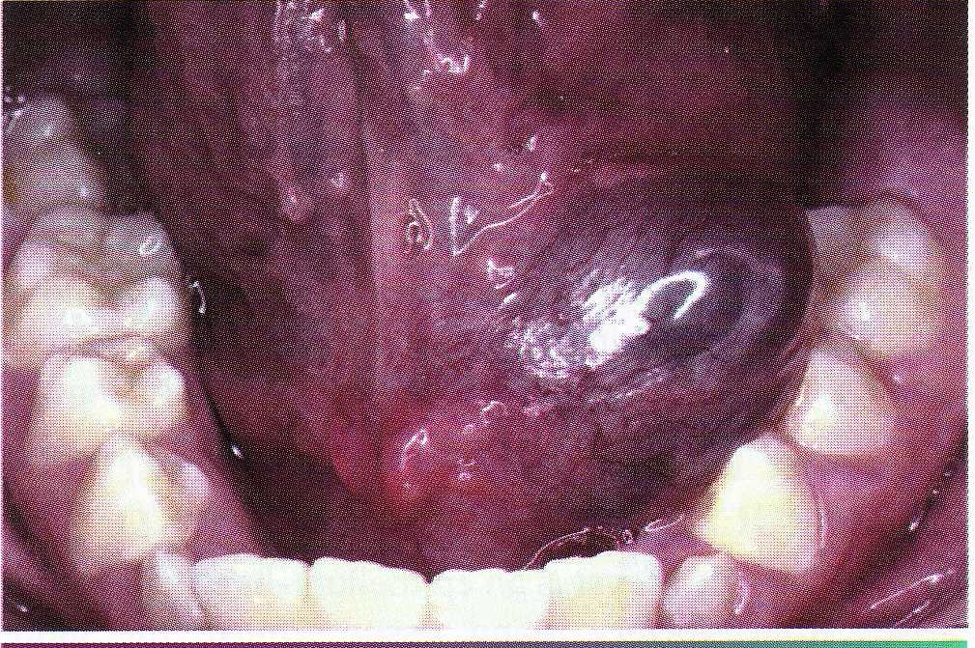
Salivary Gland Pathology
The ranula appears as a blue, dome-shape fluctuant swelling in the floor of the mouth .Deeper lesions may be normal in color. Ranulas tend to be larger than mucoceles in other oral locations; they can develop into large masses that are many centimeters in diameter,fill the floor of the mouth, and elevate the tongue. The ranula usually is located lateral to the midline.

Slide 10
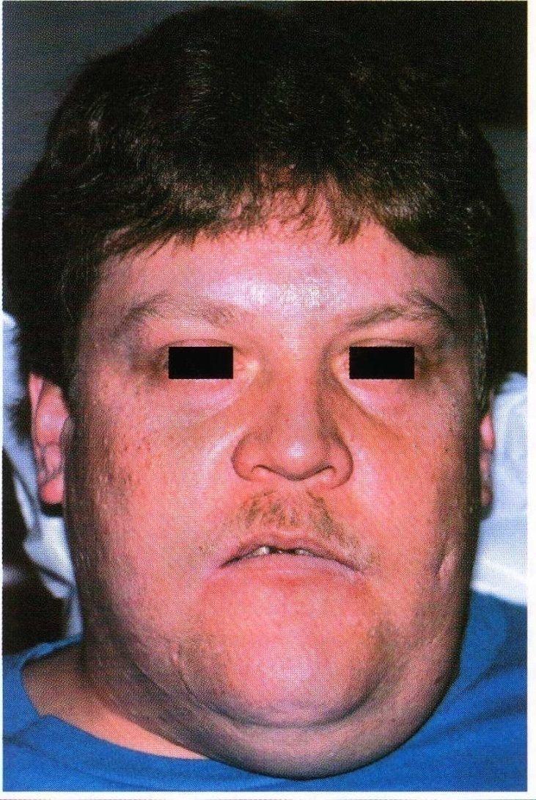
Salivary Gland Pathology
An unusual clinical variant, the plunging or cervical ranula, occurs when the spilled mucin dissects through the mylohyoid muscle and produces swelling within the Neck .A concomitant swelling in the floor of the mouth may or may not be present. If no lesion is produced in the mouth, the clinical diagnosis of ranula may not be suspected
.

Slide 11
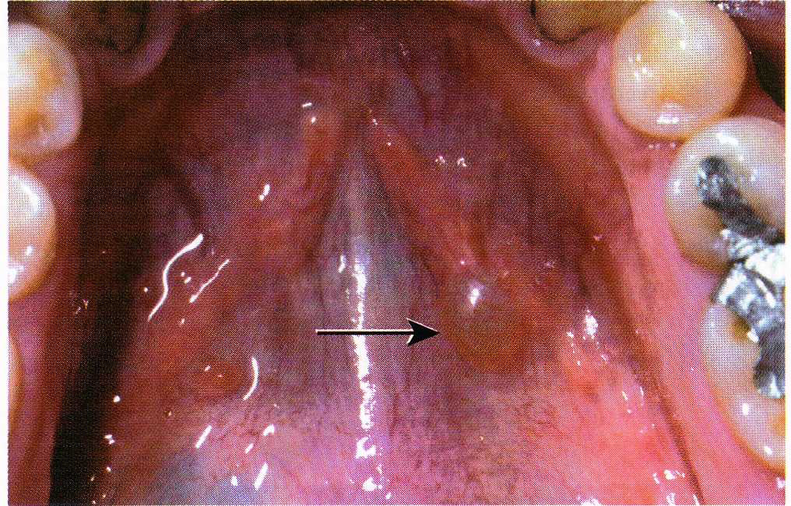
Salivary Gland Pathology
SALIVARY DUCT CYST (MUCUS RETENTION
CYST; MUCUS DUCT CYST; SIALOCYST)
The salivary duct cyst is an epithelium-lined cavity that arises from salivary gland tissue. Unlike the more common mucocele), it is a true cyst because it is lined by epithelium.

Slide 12
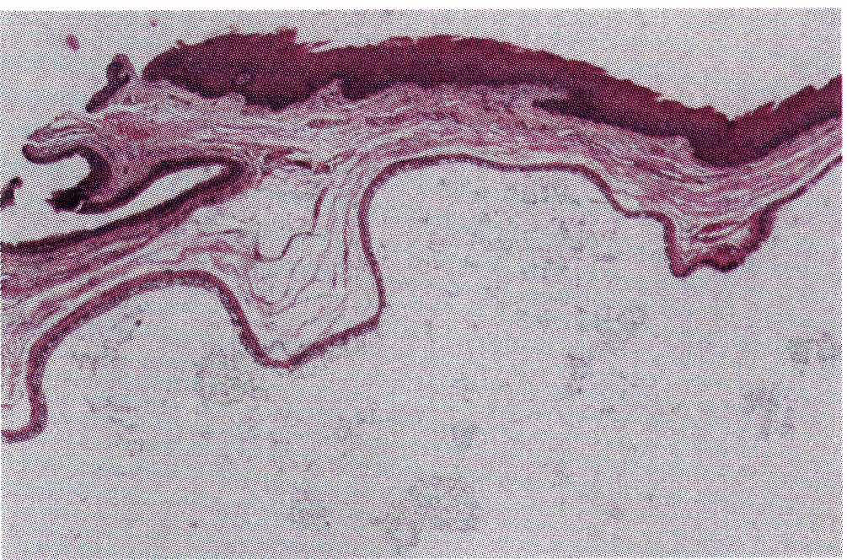
Salivary Gland Pathology
Histopathologic Features
The lining of the salivary duct cyst is variable and may consist of cuboidal, columnar, or atrophic squamous epithelium surrounding thin or mucoid secretions in the lumen

Slide 13
Salivary Gland Pathology
Treatment and Prognosis
Isolated salivary duct cysts are treated by conservative
surgical excision. For cysts in the major glands, partial
or total removal of the gland may be necessary. The lesion should not recur .

Slide 14
Salivary Gland Pathology
SIALOLITHIASIS (SALIVARY CALCULI;
SALIVARY STONES)
Sialoliths are calcified structures that develop within the salivary ductal system. They are believed to arise from deposition of calcium salts around a nidus of debriswithin the duct lumen. This debris may include mucus, bacteria, ductal epithelial cells, or foreign bodies. The cause of sialoliths is unclear, but their formation can be promoted by chronic sialadenitis and partial obstruction. Their development is not related to any systemic derangement in calcium and phosphorus metabolism .
.

Slide 15
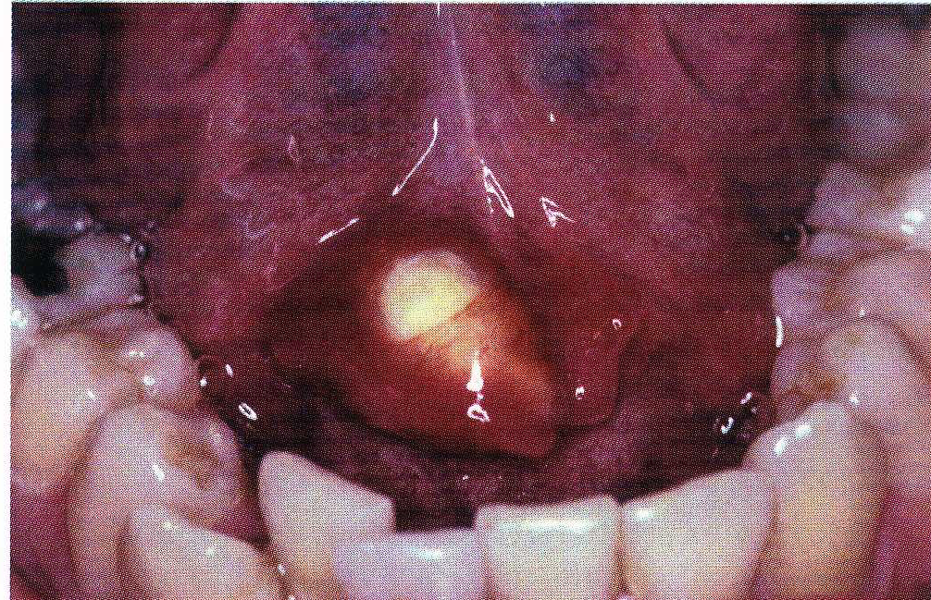
Salivary Gland Pathology

Slide 16
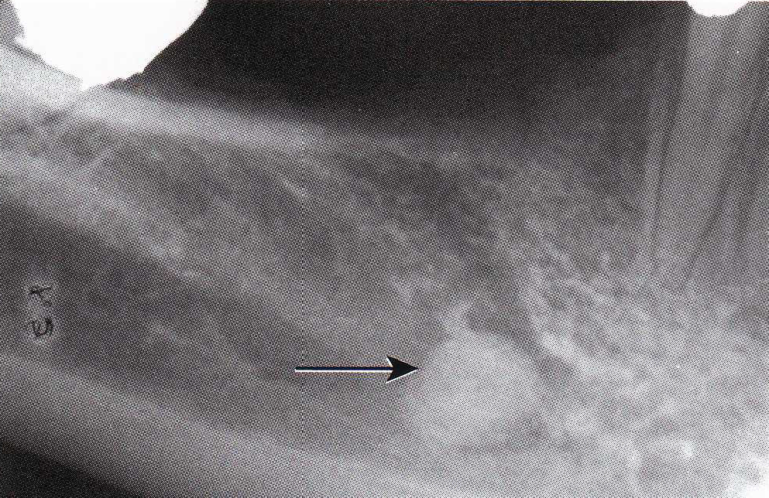
Salivary Gland Pathology
Sialoliths most often develop within the ductal system of the submandibular gland; the formation of stones within the parotid gland system is distinctly less frequent. The long, tortuous, upward path of the submandibular (Wharton's) duct and the thicker, mucoid secretions of this gland may be responsible for its greater tendency to form salivary calculi.

Slide 17
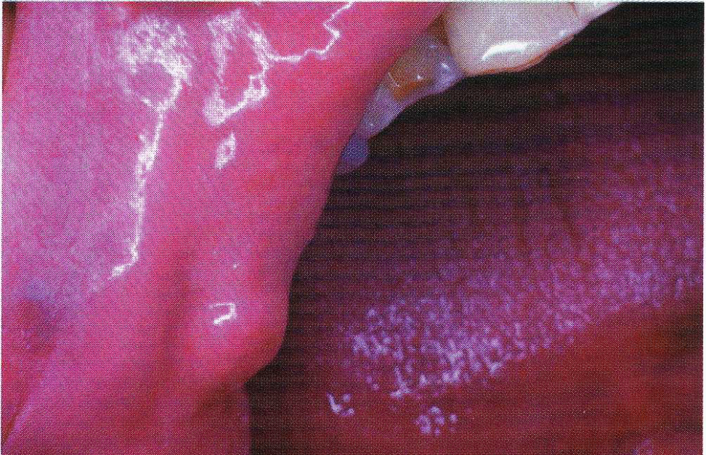
Salivary Gland Pathology
Salivary stones can occur
at almost any age, but they are most common in young and middle-aged adults.

Slide 18
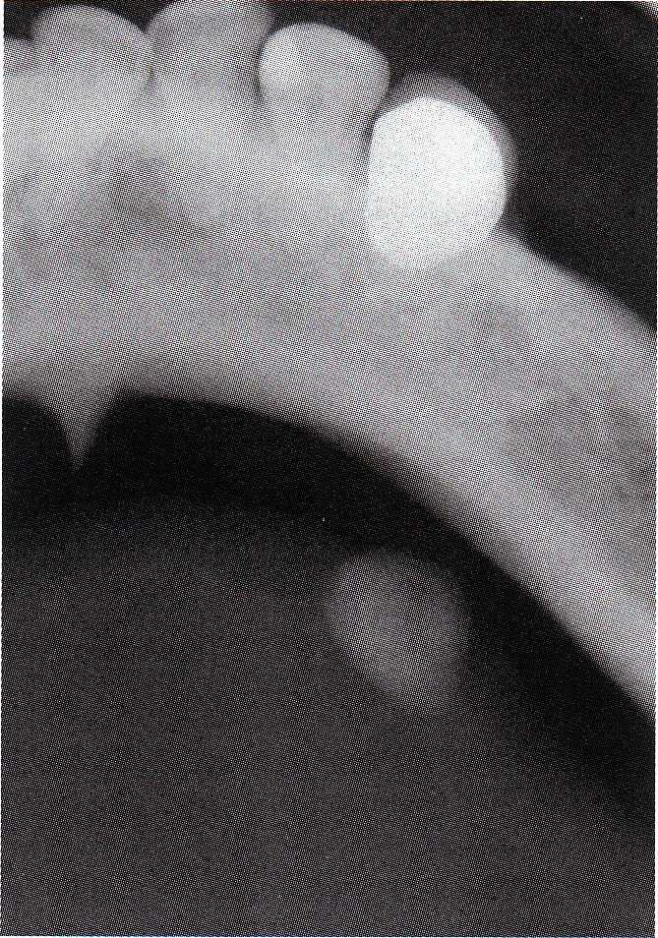
Salivary Gland Pathology
Sialoliths typically appear as radiopaque masses on radiographic examination. However, not all stones are
visible on standard radiographs (perhaps because of the degree of calcification of some lesions). They may be discovered anywhere along the length of the duct or within the gland itself. Stones in the terminal portion of the submandibular duct are best demonstrated with an occlusal
Radiograph.

Slide 19
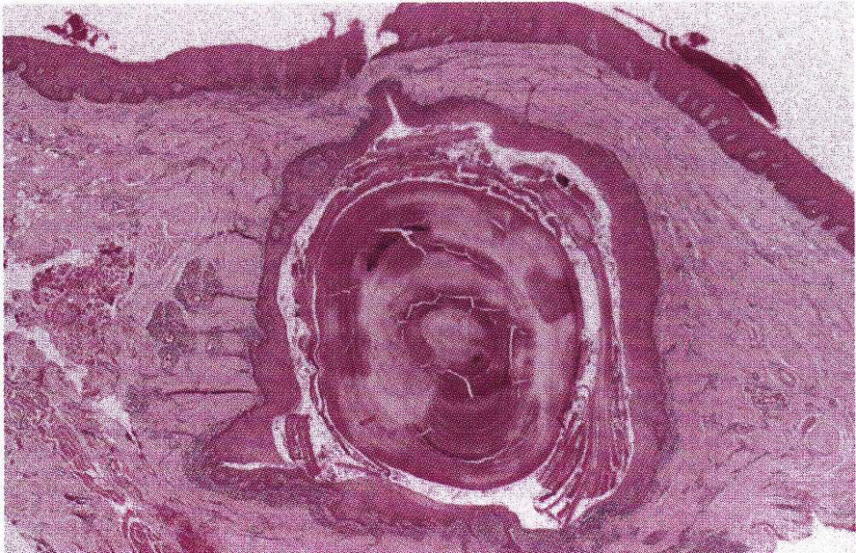
Salivary Gland Pathology
Microscopically, the calcified mass exhibits concentric laminations that may surround a nidus of amorphous
debris .
Sialolithiasis. Intraductal calcified mass showing concentric laminations. The duct exhibits squamous metaplasia.

Slide 20
Salivary Gland Pathology
Treatment and P r o g n o s i s
Small sialoliths of the major glands sometimes can be
treated conservatively by gentle massage of the gland in
an effort to milk the stone toward the duct orifice. Sialagogues(drugs that stimulate salivary flow), moist heat,
and increased fluid intake also may promote passage of
the stone. Larger sialoliths usually need to be removed
surgically. If significant inflammatory damage has
occurred within the feeding gland, the gland may need
to be removed. Minor gland sialoliths are best treated by
surgical removal, including the associated gland.

Slide 21
Salivary Gland Pathology
In the late 1800s, Johann von Mikulicz-Radecki described
the case of a patient with an unusual bilateral painless
swelling of the lacrimal glands and all of the salivary
glands. Histopathologic examination of the involved
glands showed an intense lymphocytic infiltrate, with
features that today are recognized microscopically as the
benign lymphoepithelial lesion.

Slide 22
Salivary Gland Pathology
Most benign lymphoepithelial lesions develop as a component of Sjogren syndrome. Those not associated with Sjogren syndrome are usually unilateral, although occasional bilateral examples are seen. On occasion, benign lymphoepithelial lesions occur in association with other salivary gland pathologic conditions, such as sialoliths and benign or malignant epithelial tumors.
The benign lymphoepithelial lesion most often develops in adults, with a mean age of 50 years. From 60% to 80% of cases occur in women. Eighty-five percent of cases occur in the parotid gland, with infrequent examples also reported in the submandibular gland and
minor salivary glands. The lesion usually appears as a firm, diffuse swelling of the affected gland that sometimes is dramatic in size. It may be asymptomatic or associated with mild pain.

Slide 23
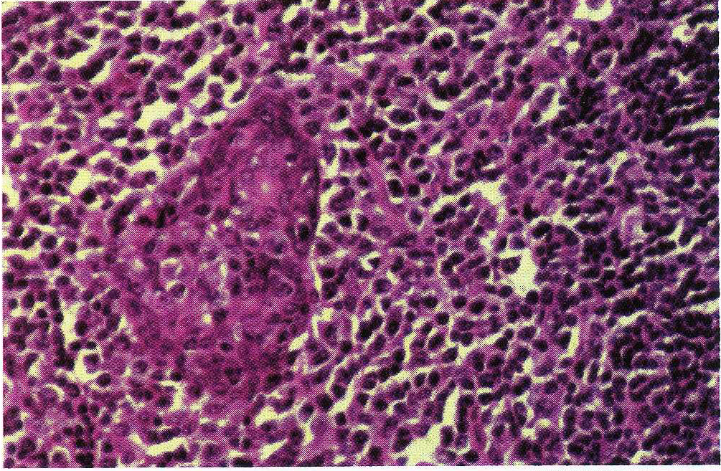
Salivary Gland Pathology
Histopathologic Features
Microscopic examination of the benign lymphoepithelial lesion shows a heavy lymphocytic infiltrate associated with the destruction of the salivary acini.
Germinal centers may or may not be seen. Although the acini are destroyed, the ductal epithelium persists. The ductal cells and surrounding myoepithelial cells become hyperplastic, forming highly characteristic groups of
cells, known as epimyoepithelial islands, throughout the
lymphoid proliferation.

Slide 24
Salivary Gland Pathology
The presence of epimyoepithe-islands once was considered indicative of a benign process, but now it is recognized that these islands also
can be found in low-grade salivary lymphomas which is called:
mucosa-associated lymphoid tissue (MALT lymphomas).

Slide 25
Salivary Gland Pathology
Treatment a n d Prognosis
Although the benign lymphoepithelial lesion frequently
necessitates surgical removal of the involved gland, the
prognosis in most cases is good. However, individuals
with benign lymphoepithelial lesions have an increased
risk for lymphoma, either within the affected gland or in
an extrasalivary site. Although the exact risk is uncertain,
one study showed the risk in patients with Sjogren
syndrome to be more than 40 times higher than expected
in the general population.

Slide 26
Salivary Gland Pathology
SjOGREN SYNDROME
Sjogren syndrome is a chronic, systemic autoimmune disorder that principally involves the salivary and lacrimal glands, resulting in xerostomia (dry mouth) and xerophthalmia (dry eyes). The effects on the eye often are called keratoconjunctivitis sicca (sicca = dry), and the clinical presentation of both xerostomia and xerophthalmia
is also sometimes called the sicca syndrome. Two forms of the disease are recognized:
1. Primary Sjogren syndrome (sicca syndrome alone; no other autoimmune disorder is present)
2. Secondary Sjogren syndrome (the patient manifests sicca syndrome in addition to another associated autoimmune disease)

Slide 27
Salivary Gland Pathology
When the condition is associated with another connective tissue disease, it is called secondary Sjogren syndrome.
It can be associated with almost any other autoimmune disease, but the most common associated disorder is rheumatoid arthritis. About 15% of patients with rheumatoid arthritis have Sjogren syndrome. In addition, secondary Sjogren syndrome may develop in 30% of patients with systemic lupus erythematosus

Slide 28
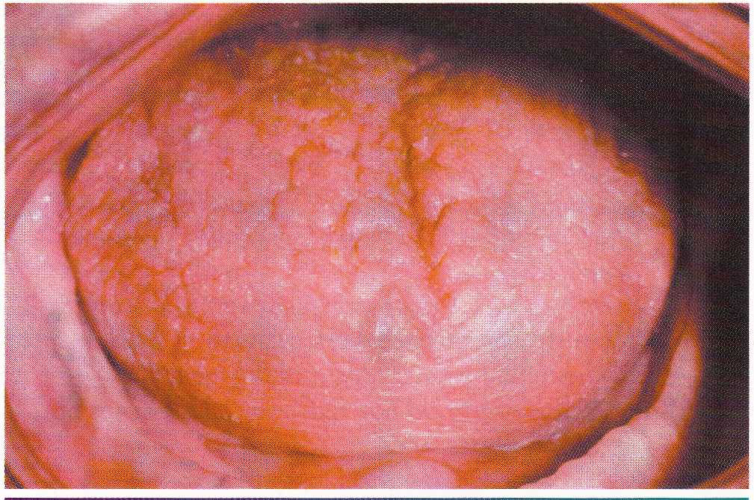
Salivary Gland Pathology
The principal oral symptom is xerostomia, which is caused by decreased salivary secretions; however, the severity of this dryness can vary widely from patient to patient. The saliva may appear frothy, with a lack of the usual pooling saliva in the floor of the mouth. Affected patients may complain of difficulty in swallowing, altered taste, or difficulty in wearing dentures. The tongue often becomes fissured and exhibits atrophy of the papillae

Slide 29
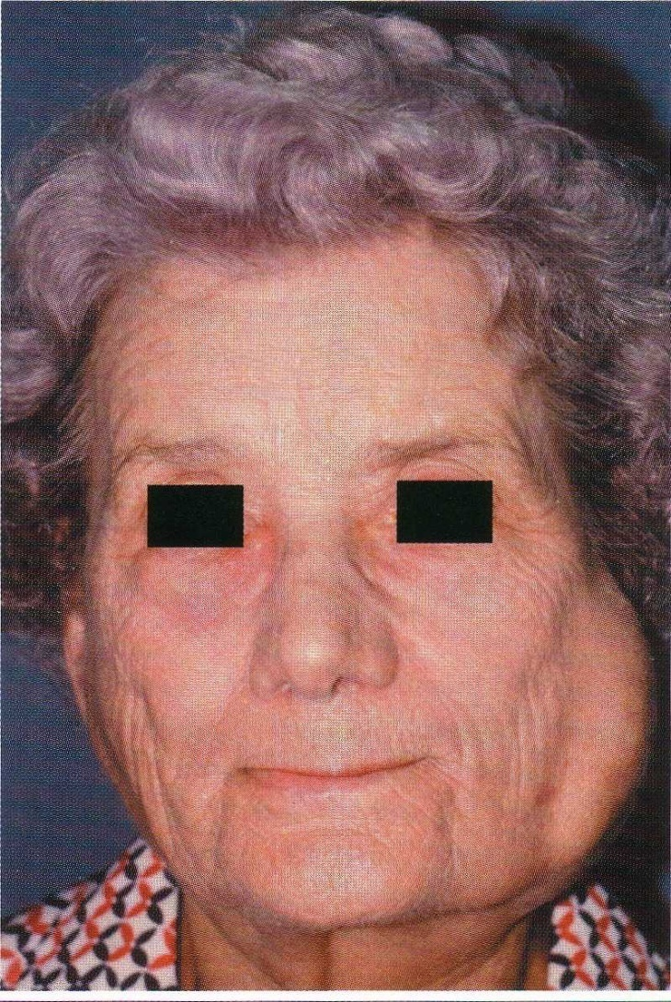
Salivary Gland Pathology
From one third to one half of patients have diffuse,
firm enlargement of the major salivary glands during the course of .their disease

Slide 30
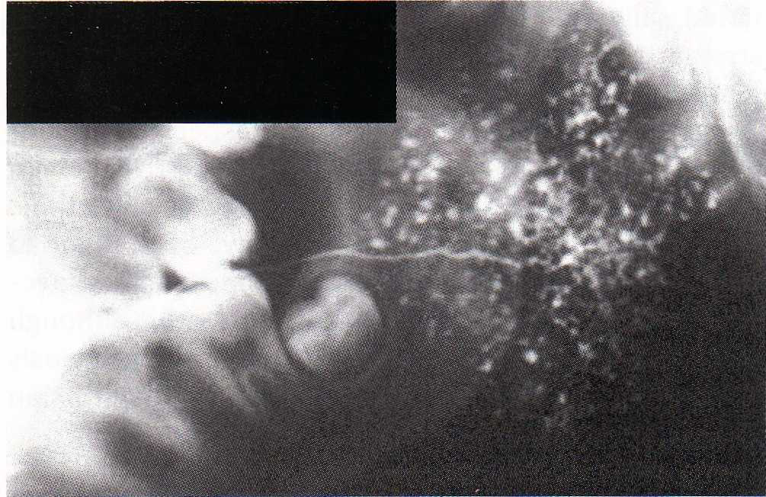
Salivary Gland Pathology
Although it is not diagnostic, sialographic examination often reveals punctate sialectasia and lack of normal arborization of the ductal system, typically demonstrating
a "fruit-laden, branchless tree" pattern.

Slide 31
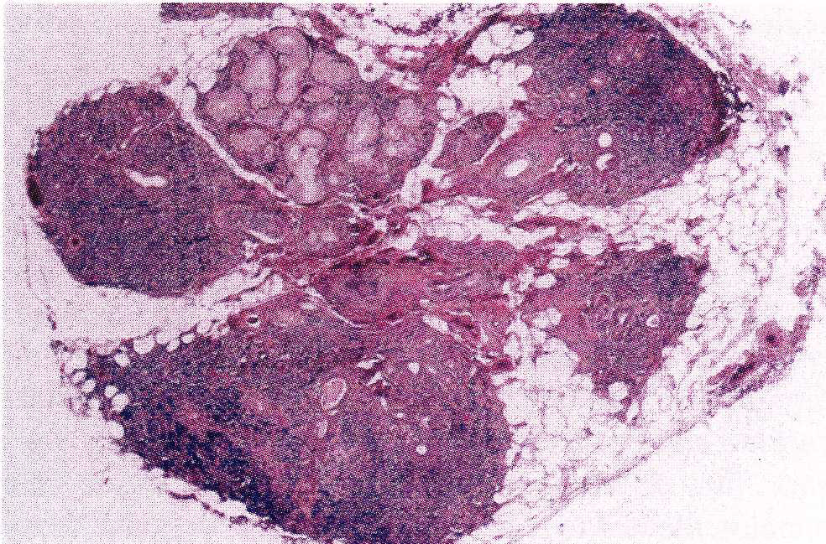
Salivary Gland Pathology
Histopathologic Features
The basic microscopic finding in Sjogren syndrome is a
lymphocytic infiltration of the salivary glands, with destruction of the acinar units. If the major glands are enlarged, microscopic examination usually shows progression
.to a lymphoepithelial lesion

Slide 32
Salivary Gland Pathology
Treatment and Prognosis
The treatment of the patient with Sjogren syndrome is
mostly supportive.

Slide 33
Salivary Gland Pathology
SIALADENOSIS (SIALOSIS)
Sialadenosis is an unusual noninflammatory disorder characterized by salivary gland enlargement, particularly involving the parotid glands. The condition frequently is associated with an underlying systemic problem, which may be endocrine, nutritional, or neurogenic in origin (Box 11-3). The best known of these con ditions include diabetes mellitus, general malnutrition,alcoholism, and bulimia.
These conditions are believed to result in dysregulation
of the autonomic innervation of the salivary acini,causing an aberrant intracellular secretory cycle. This leads to excessive accumulation of secretory granules,with marked enlargement of the acinar cells.

Slide 34
Salivary Gland Pathology
Conditions Associated With
Sialadenosis
A. ENDOCRINE
+► Diabetes mellitus
♦ Diabetes insipidus
• Acromegaly
• Hypothyroidism
• Pregnancy
B. NUTRITIONAL
4, General malnutrition 4
. Alcoholism
4 Anorexia nervosa
• Bulimia
C. NEUROGENIC MEDICATIONS
Antihypertensive drugs
• Psychotropic drugs
• Sympathomimetic drugs used for treating asthma

Slide 35
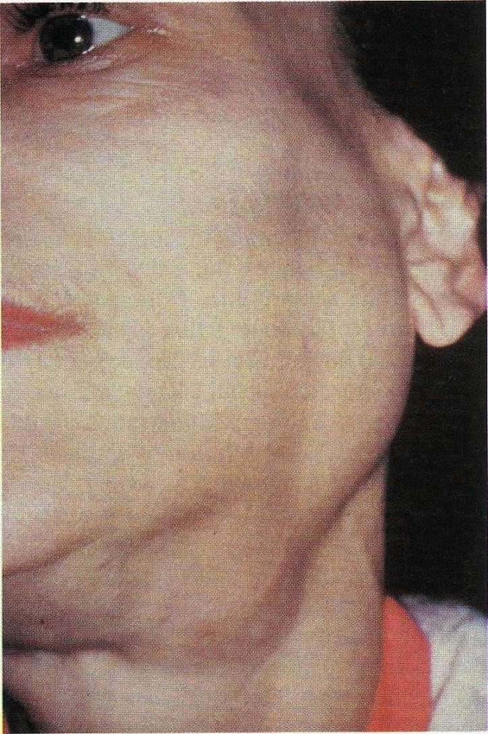
Salivary Gland Pathology
Sialadenosis usually appears as a slowly evolving swelling of the parotid glands, which may or may not be
Painful .The condition is usually bilateral, but it also can be unilateral.

Slide 36
Salivary Gland Pathology
Histopathologic Features
Microscopic examination reveals hypertrophy of the acinar cells, sometimes two to three times greater than normal size. The nuclei are displaced to the cell base,and the cytoplasm is engorged with zymogen granules.
In cases associated with longstanding diabetes or alcoholism,there may be acinar atrophy and fatty infiltration.
Significant inflammation is not observed.
Treatment and Prognosis
The clinical management of sialadenosis is often unsatisfactory
because it is closely related to the control of the underlying cause. Mild examples may cause few problems.
If the swelling becomes a cosmetic concern, partial parotidectomy can be performed. Pilocarpine recently has been reported to be beneficial in the treatment of
bulimic patients with sialadenosis.

Slide 37
Salivary Gland Pathology
NECROTIZING SIALOMETAPLASIA
Necrotizing sialometaplasia is an uncommon, locally
destructive inflammatory condition of the salivary glands. Although the cause is uncertain, most believe it is the result of ischemia of the salivary tissue that leads to local infarction. The importance of this lesion rests in the fact that it mimics a malignant process,both clinically and microscopically.

Slide 38
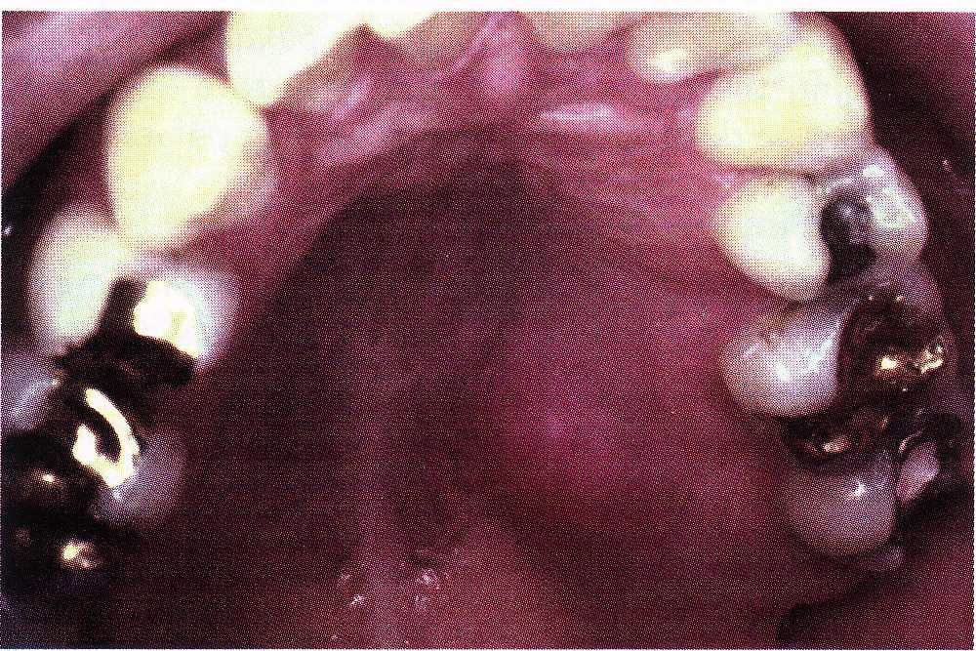
Salivary Gland Pathology
A number of potential predisposing factors have been suggested, including the following:
♦ Traumatic injuries
♦ Dental injections
♦ III-fitting dentures
♦ Upper respiratory infections
♦ Adjacent tumors
♦ Previous surgery

Slide 39
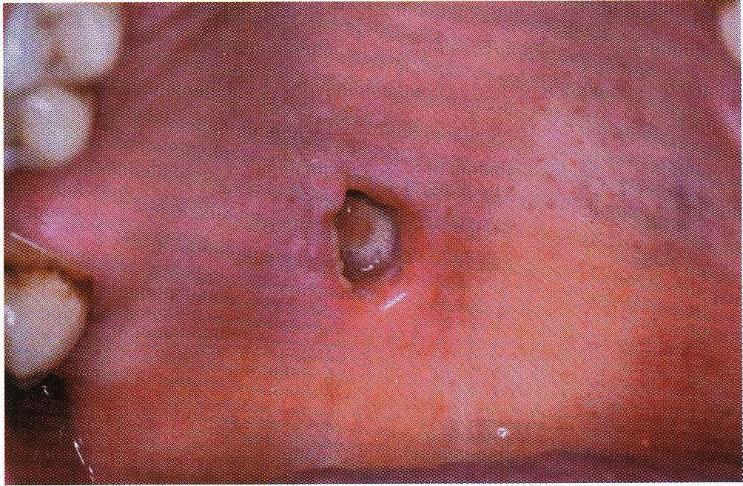
Salivary Gland Pathology
The condition appears initially as a nonulcerated swelling, often associated with pain orparesthesia .Within 2 to 3 weeks, necrotic tissue sloughs out,leaving a craterlike ulcer that can range from less than1 cm to more than 5 cm in diameter. The patient may report that "a part of my palate fell out." At this point, the pain often subsides. In rare instances,there can be destruction of the underlying palatal bone.

Slide 40
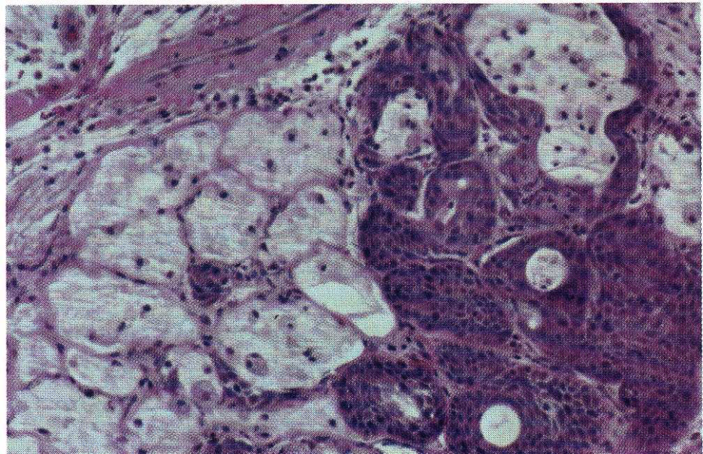
Salivary Gland Pathology
Histopathologic Features
The microscopic appearance of necrotizing sialometaplasia is characterized by acinar necrosis in early lesions, followed by associated squamous metaplasia of the salivary ducts. Although the mucous acinar cells are necrotic, the overall lobular architecture of the involved glands is still preserved—a helpful histopathologic clue. There may be liberation of mucin,with an associated inflammatory response. The squamous metaplasia of the salivary ducts can be striking and produce a pattern that is easily misdiagnosed as squamous cell carcinoma or mucoepidermoid carcinoma.
Necrotizing sialometaplasia. Necrotic mucous
acini (left) and adjacent ductal squamous metaplasia (right).

Slide 41
Salivary Gland Pathology
Treatment and Prognosis
Because of the worrisome clinical presentation of necrotizing sialometaplasia, biopsy usually is indicated to ruleout the possibility of malignant disease. Once the diagnosis has been established, no specific treatment is indicated or necessary. The lesion typically resolves on its own accord, with an average healing time of 5 to 6 weeks.

Slide 42
Salivary Gland Pathology

Slide 43
Salivary Gland Pathology

