Slide 1
In The Name Of God

Slide 2
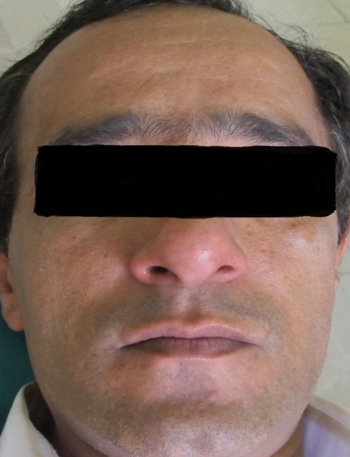
Patient Profile
Gender: male
Age: 45
Occupation: Orthopedic resident
Chief complaint:
“ I have bleeding in my gum and my upper anterior tooth is loosing and I also have bad breath ”

Slide 3
Medical History
General health : Generally good
Familial History : None of his family members were involved

Slide 4
Dental History
Oral hygiene: poor
Periodontal Therapy: No
Missing teeth: No

Slide 5
Extraoral Examination
Within Normal Limit
No Palpable Lymph Node
No Facial Asymmetry

Slide 6
Examination
Internal Examination :
Gingiva
color: Bluish red
bleeding: positive BOP
surface texture: Stippled
contour:
Marginal : Scalloped & Round
Papillary: Blunt
consistency: Loose

Slide 7
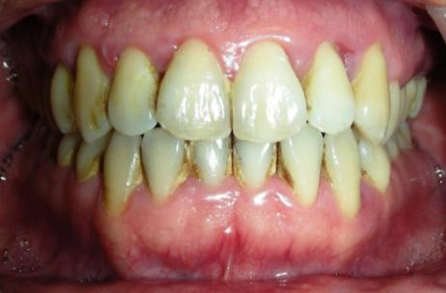
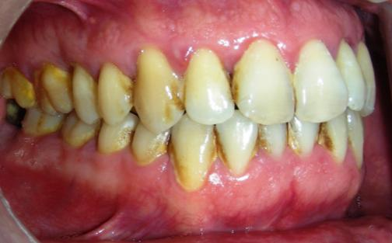
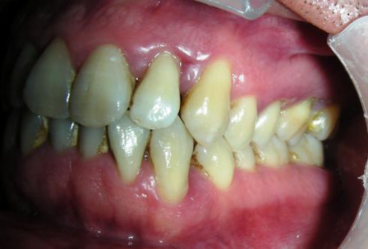

Slide 8
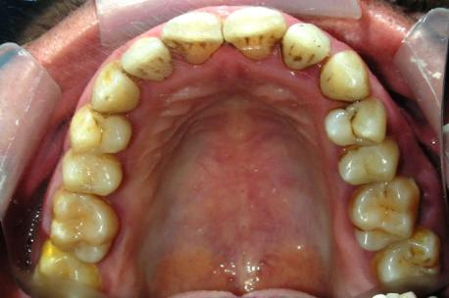
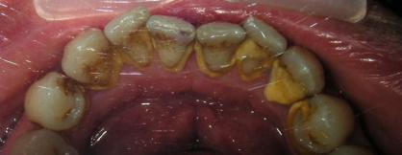

Slide 9
Other Periodontal Findings
Pathologic Migration # 11
Mobility :
grade Ι: # 21 , 22
grade ΙΙΙ; # 11
Furcation Involvement:
grade Ι: # 46 ( buccal furca)
# 17 ( distal furca)
O’Leary Index : 55%

Slide 10
O’Leary Index : 55%

Slide 11
Etiology
Bacterial Plaque: Moderate
Supra and Subgingival calculus: Moderate
Calculus former
Mucosal saliva
Habits: Clenching
Frenum pull: Nothing

Slide 12
Clinical Assessment

Slide 13
Radiographic Assessment
Furcation involvement:
Horizontal bone loss:
Vertical bone loss:
6
6
7
50%
20%
20%
30%
10%
10%
2-3
6-5
5-6-7

Slide 14
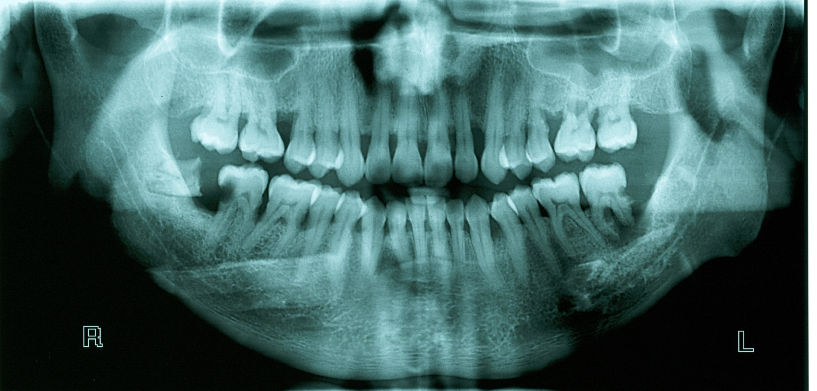

Slide 15
Diagnosis
Age: 45
Amount of destruction consist with local factors
Subgingival calculus was frequently found
> 30% of sites were involved
3 _4mm of clinical attachment loss in most of sites

Slide 16
What is diagnosis?
Generalized Moderate-Severe Chronic Periodontitis

Slide 17
Overall prognosis
45 male
Severe inflammation
Patient with fair cooperation
Poor oral hygiene
Mobile teeth ( # 11 , 21 , 22 )
without systemic disease and environment factors
Generalized and mild bone loss ( 20%)
Moderate periodontal disease

Slide 18
Overall prognosis :
Fair to Good

Slide 19
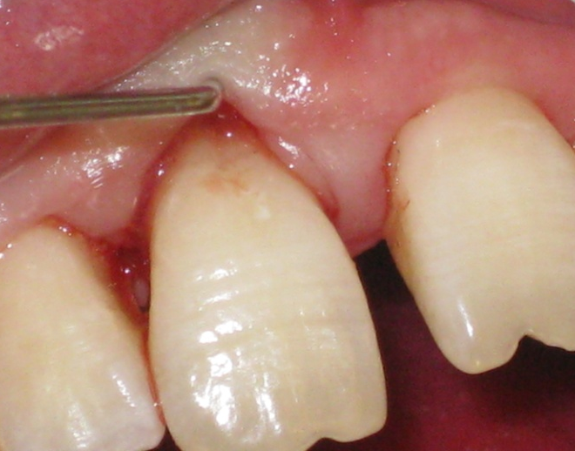
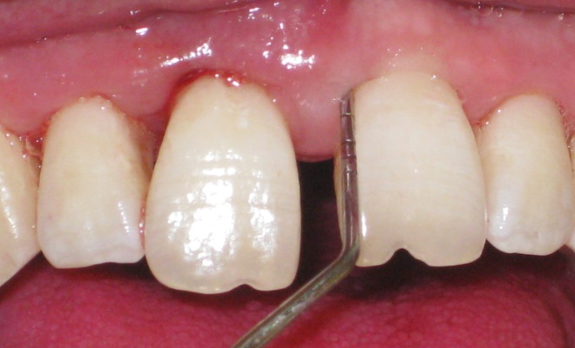
Individual prognosis :
1 :
mobility ΙΙΙ
deep pocket depth (9 mm)
Have 70% bone loss
Developing groove
1 2 :
mobility Ι
deep pocket depth (5-6 mm)
Bone loss 30%
hopeless
fair to good

Slide 20
Treatment plan
Cause related phase (phase Ι)
Scaling and root planning
Oral hygiene instruction
Excavation of caries and restoration # 45 , 46
Evaluation of response to non surgical phase
Surgical phase ( phase ΙΙ)
Flap surgery and periodontal therapy
Extraction of # 25, 26, 48
Restorative phase (phaseΙΙΙ)
Final restoration # 45 , 46
Maintenance phase (phase ΙV)
Plaque and calculus
Gingival inflammation and pockets

Slide 21
Cause related phase (phase Ι)

Slide 22
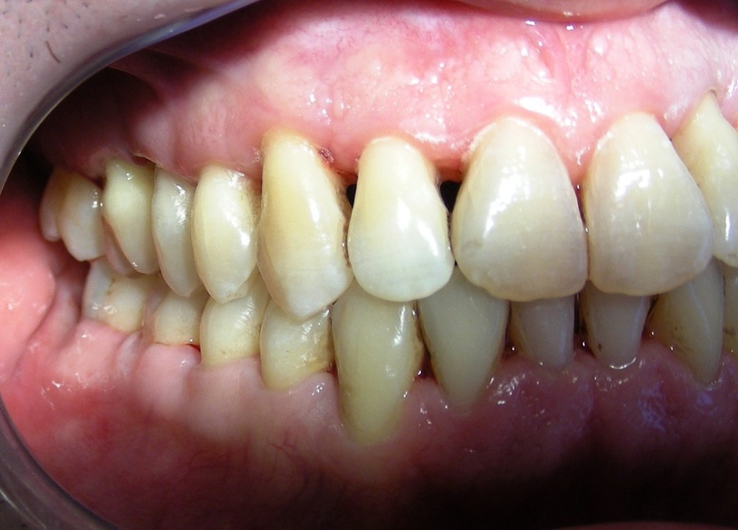
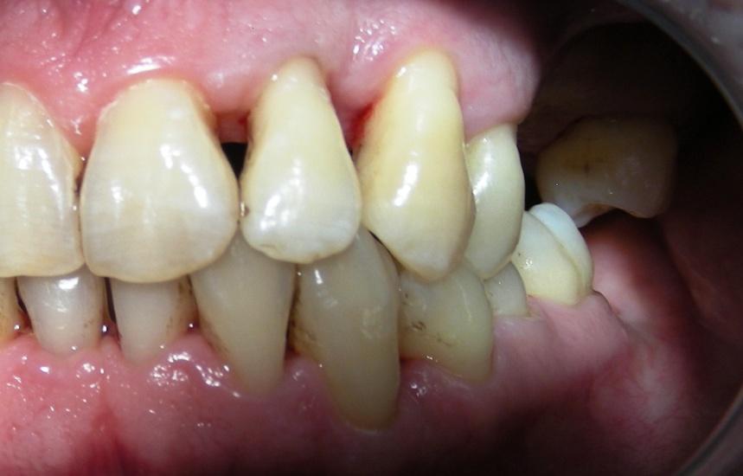
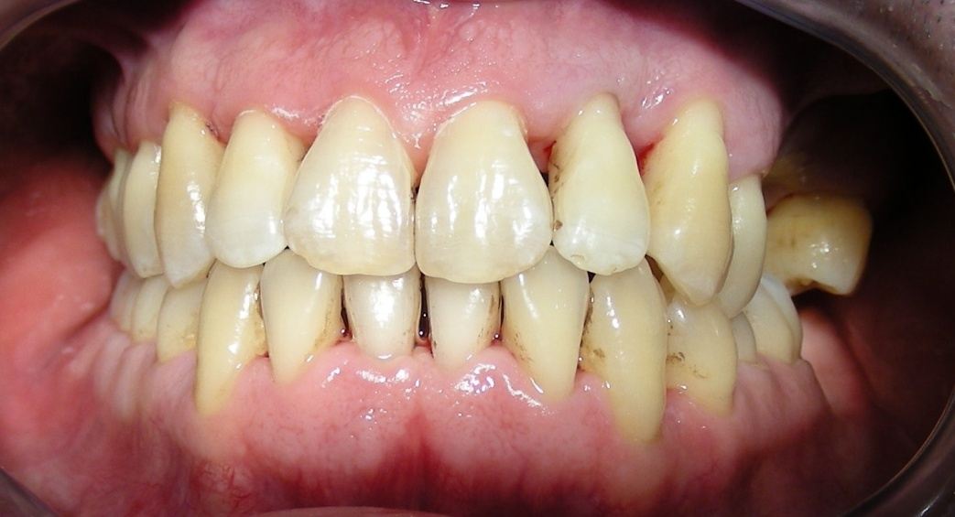
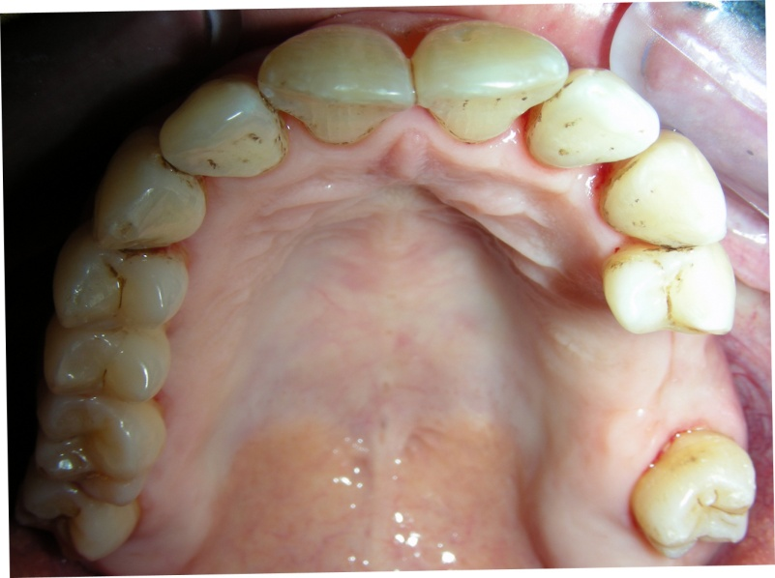
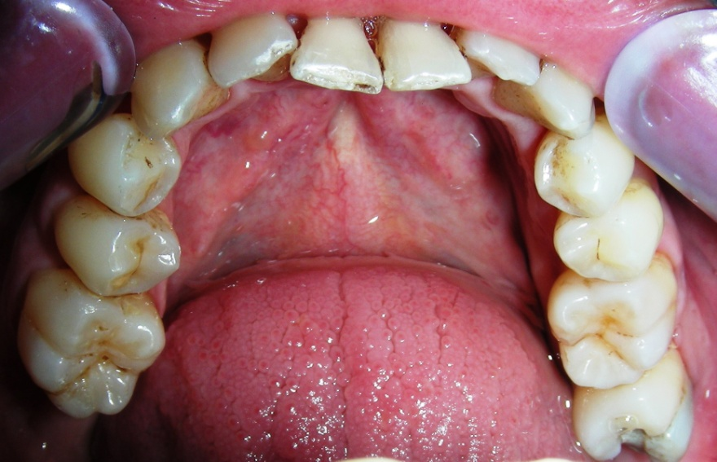

Slide 23
surgical phase ( phase ΙΙ)

Slide 24
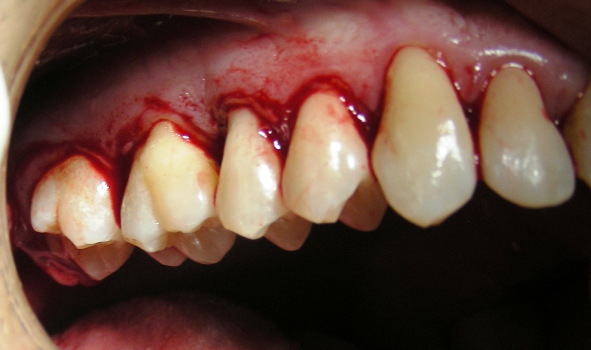
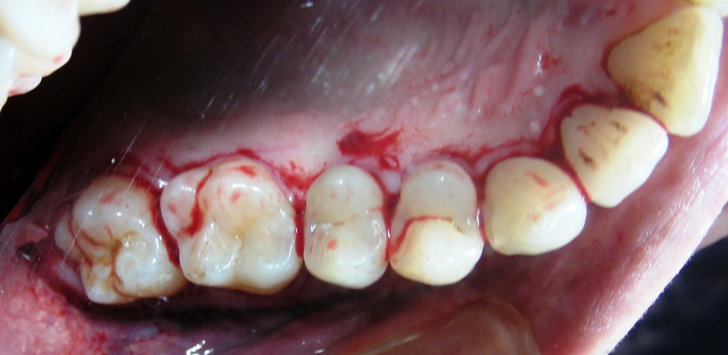

Slide 25
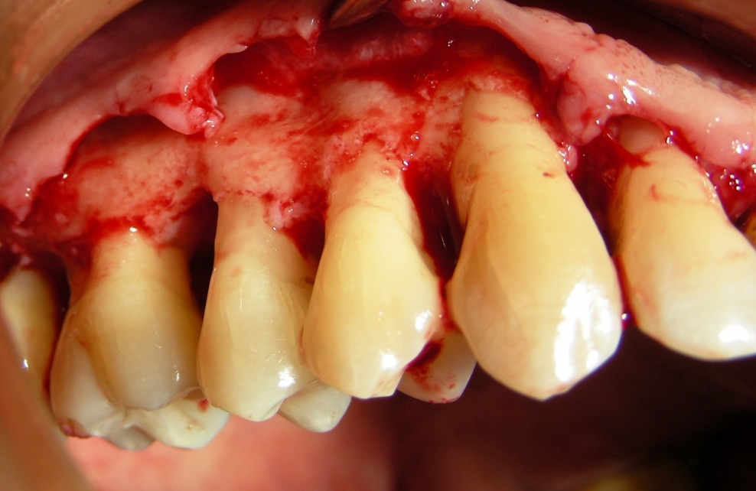
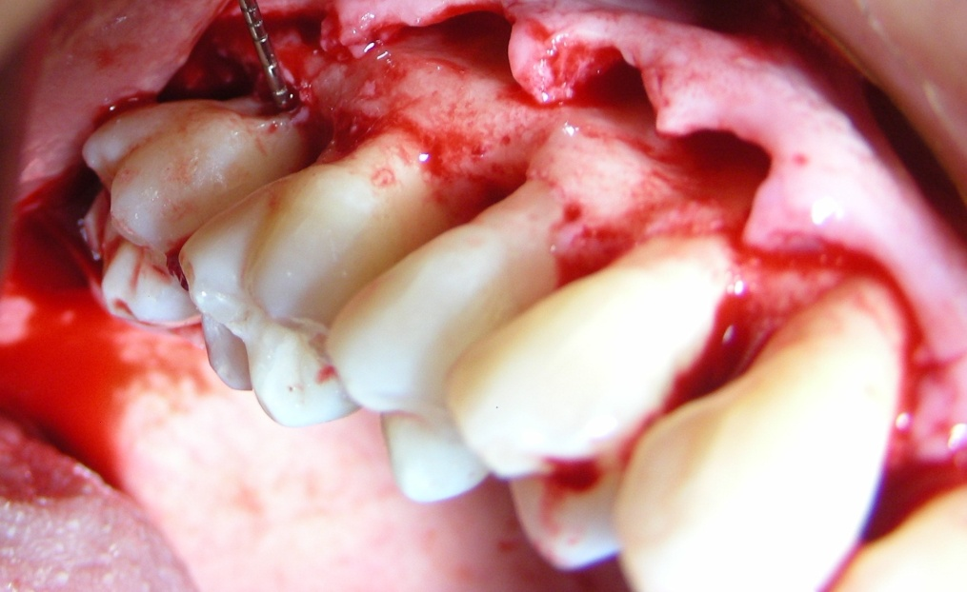

Slide 26
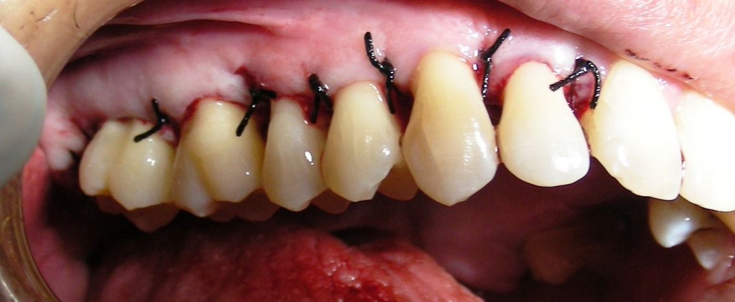
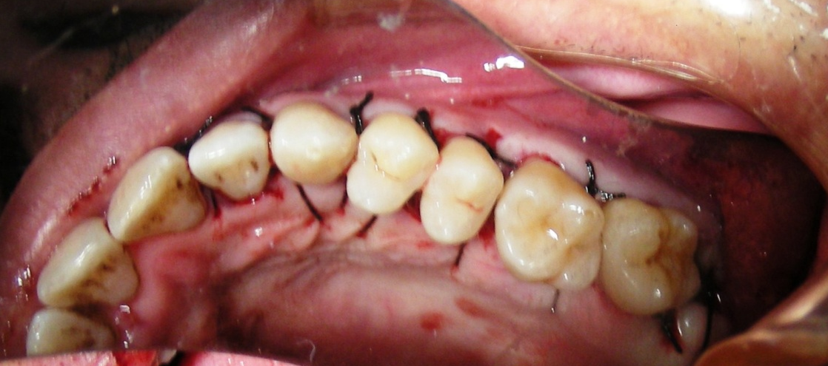

Slide 27
maintenance phase (phase ΙV)

Slide 28
The End

